Slide 1


Veoride Scooters
Usage & The UMD Bus Transportation System
Mikpongbeho Antoine Vignon, Marwa Mansour
Notes:
Hi, My name is Antoine; I am joined here by my colleague Marwa. And We will discuss our study of the Veoride Scooters Usage and the UMD bus transportation system.

Slide 2
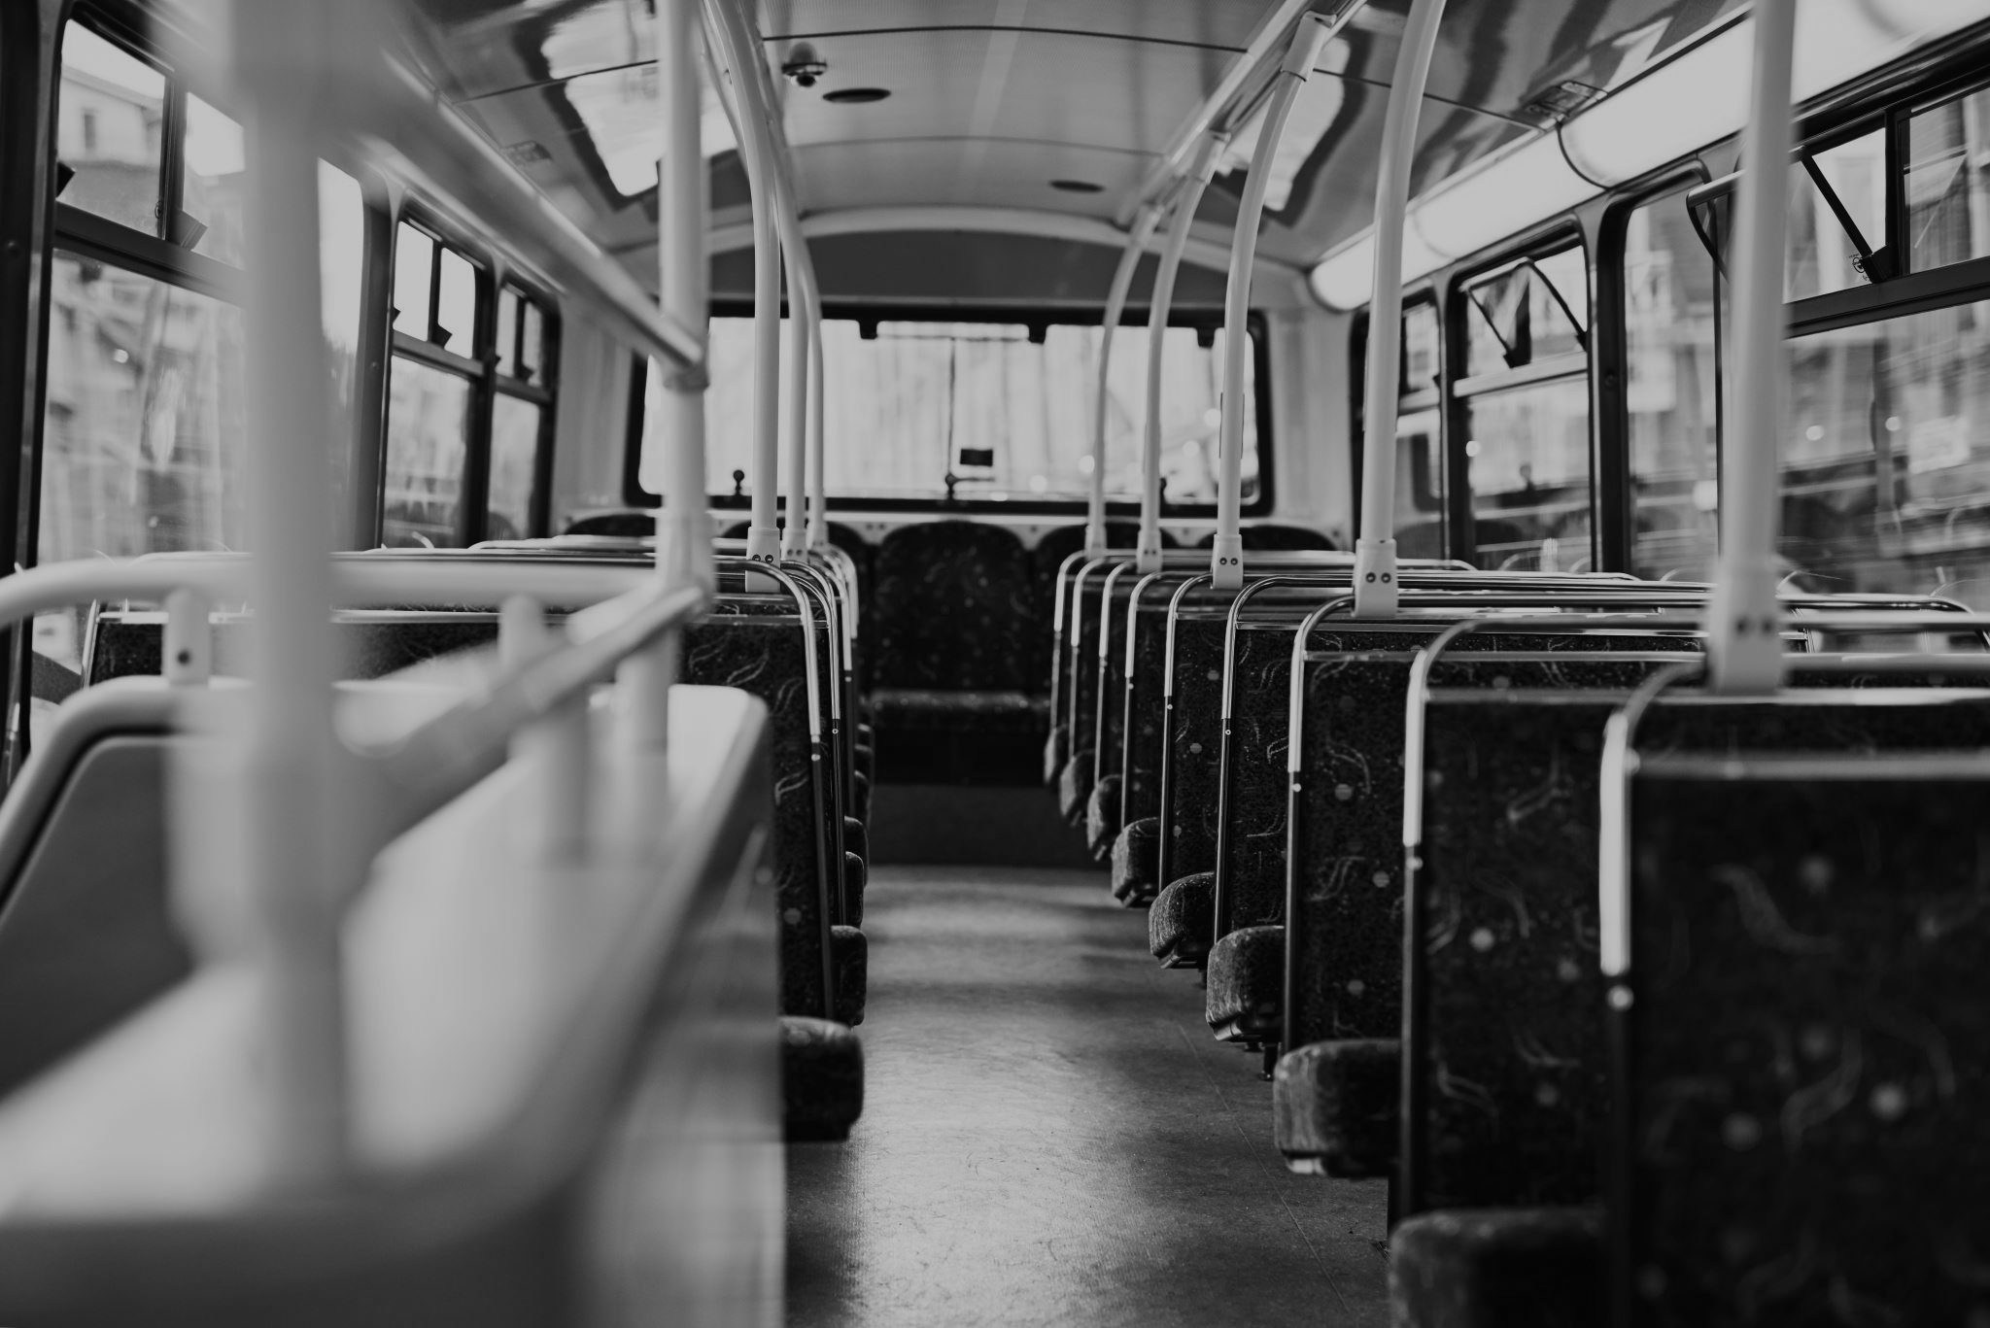
INVESTIGATE HOW OFTEN E-SCOOTERS ARE USED TO COMMUTE TO BUS STOPS ON CAMPUS
IDENTIFY POPULAR E-SCOOTER PARKING AREAS
RECOMMENDATIONS
Notes:
Here we wanted to study how the scooters are being used to complement the bus transportation on campus.
We investigate how often the scooters are used to commute to bus stops on campus and around campus.
Then we identify popular E-Scooter Parking areas,
Finally, we will talk about one of the surprising discoveries we made during the process.
And offer recommendations to DOT based on these facts.

Slide 3


DATASETS
VeoRide data generated from individual rides (CSV)
The dataset comprises 62 days (October 2020 and October 2019) of historical data
Includes: RIDE ID, CUSTOMER ID, CREATED (time), START (time), END (time), DISTANCE, MINUTES, VEHICLE TYPE, PATH (json dict), TIMESTAMPS (list), START POINT, END POINT
The dataset is an anonymized dataset.
Additional datasets kindly provided by DOTS (through UMD GIS dept.)
UMD Campus map
UMD VeoParking Areas
Shuttle-UM Bus stop locations
WMATA bus stop locations on campus
We only used End Points from each ride for our analysis
The University of Maryland Department of Transportation Services (DOTS) provides a full range of parking and transportation services to a diverse community of more than 50,000 students, faculty and staff in the City of College Park
VeoRide Inc., is a mobility service provider that manages their micro mobility fleet through the use of the Mobility Data Standard (MDS)
Notes:
Our primary dataset provided by DOT is the VeoRide data generated from individual rides ...
In addition, we obtain the following dataset for our analysis.
Our analysis only focuses on end rides.

Slide 4
PROCEDURE
CLEAN AND ORGANIZE DATA
(Python - Pandas)
PRELIMINARY ANALYSIS (Python /
Tableau)
VISUALIZATION AND FOCUS ANALYSIS
(ArcGIS)
CONCLUSION AND RECOMMENDATION
Notes:
Here is a representation of the structure of our analysis.
We want to emphasize that this is not a linear process. Often we come back to either the Organization stage or the preliminary analysis stage as necessary.
An example of this is having to remove the path and timestamp columns after running into trouble in GIS during the Focus analysis stage.

Slide 5
DATA CLEANING AND ORGANIZATION
Notes:
Next, let's talk about the Cleaning and organization stage.

Slide 6
Cleaning & Organization Process
Cleaning
Removed E-Bike rides from dataset.
Removed missing values (from distance variable).
Removed rides with distances less than 0.08 miles.
Removed unnamed columns.
Dataset before cleaning: (40325 rows , 16 columns)
Dataset after cleaning: (34555 rows, 14 columns)
Organization
Used CREATED column to create a YEAR column.
Separated rides by year 2019 and 2020
Dropped PATH and TIMESTAMP columns to facilitate analysis.
Clean datasets after organization:
2019: (14391 rows, 15 columns)
2020: (20164 rows, 15 columns)
Notes:
During this stage,
First, we removed E-Bikes and missing values from the data.
We also removed distances that are less than 0.08 miles.
We ended up with 34555 rows of ride entries compared to 40325 rows from the raw data.
Then, we organized the data by separating the rides by year.
At the end of this stage, we had
2019 rides with 14391 entries and 2020 rides with 20164 entries. This was surprising to us because we were expecting fewer rides in 2020 due to the pandemic.

Slide 7
PRELIMINARY ANALYSIS
Notes:
The next stage is the Preliminary analysis. Here we familiarize ourselves with the dataset.

Slide 8
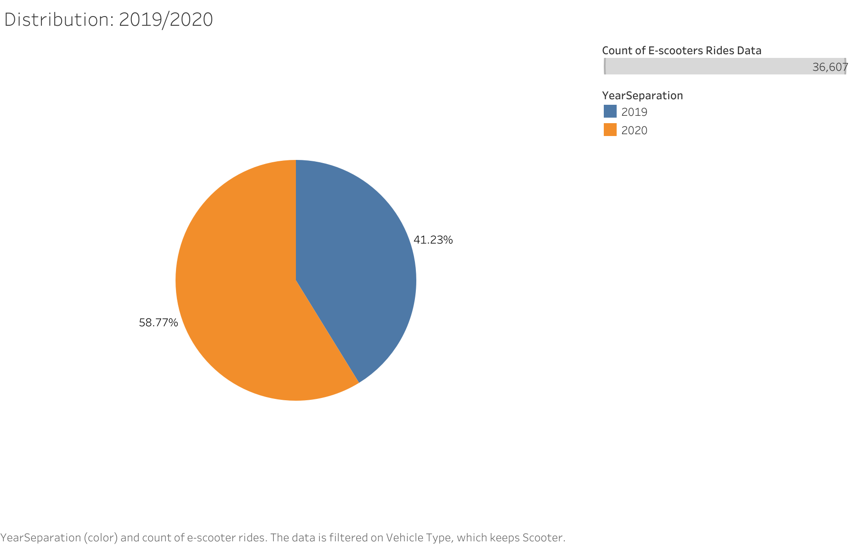
Distribution
This chart shows the distribution of scooter rides between the two time periods (Oct. 2019 & Oct. 2020).
Notes:
We looked at the distribution on the rides.
This image shows the distribution of the rides for the years 2019 in blue and 2020 in orange.

Slide 9
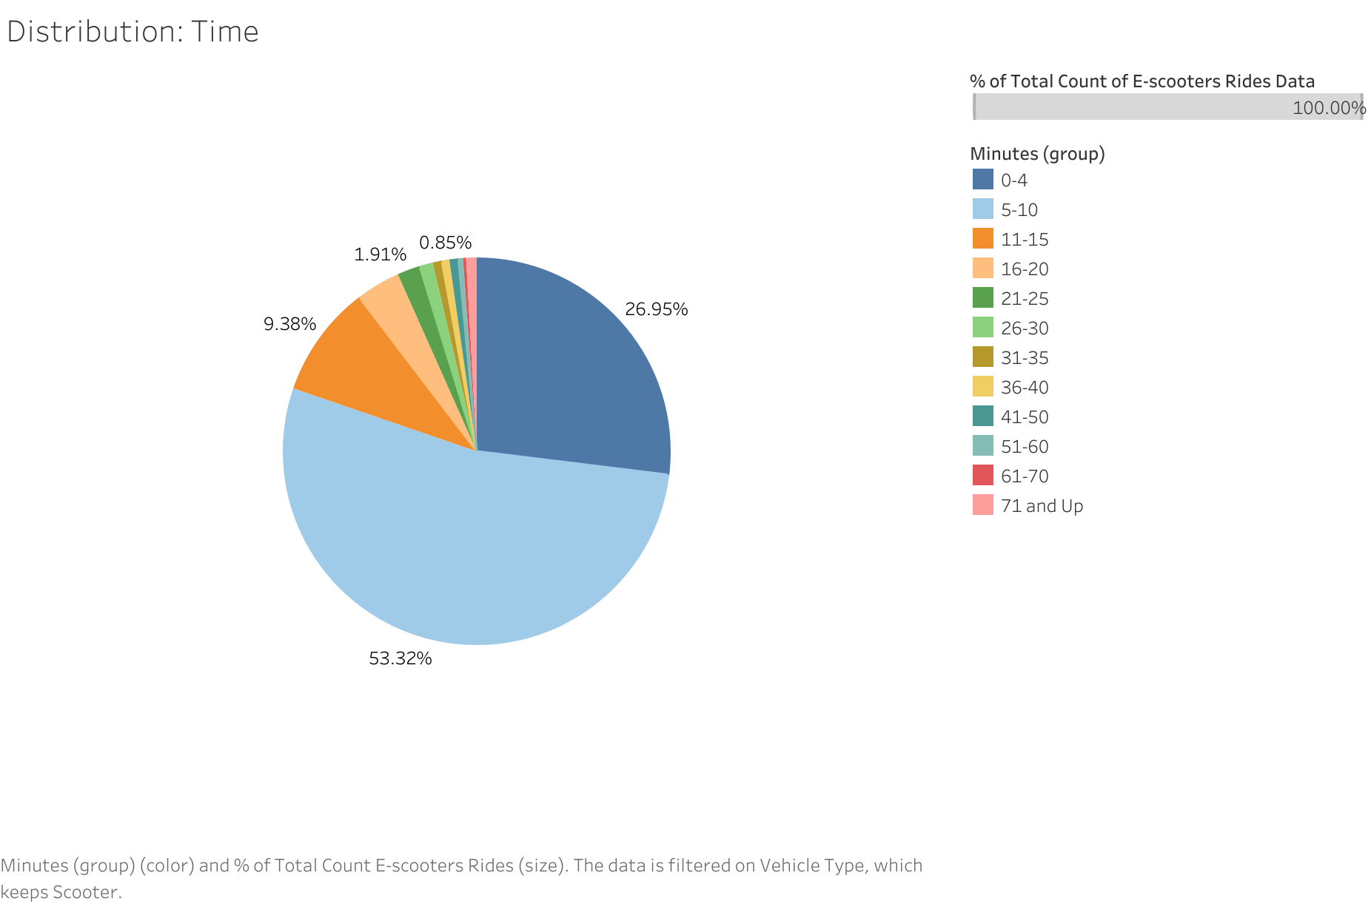
Time
This chart shows the distribution of scooter ride Time (Minutes) among the dataset by color.
Notes:
We also looked at the Time distribution of all the rides.
Here in light blue, we have rides that are between 5 and 10 minutes, in dark blue rides that are between 0 and 4 minutes, in orange rides between 11 and 15 minutes, and so on, as shown on the right.
We can see that more than half of the rides are between 5 and 10 minutes—about 53%, to be exact. Next, 26% of the rides are between 0 and 4 minutes, and 9% are between 11 and 15 minutes.

Slide 10
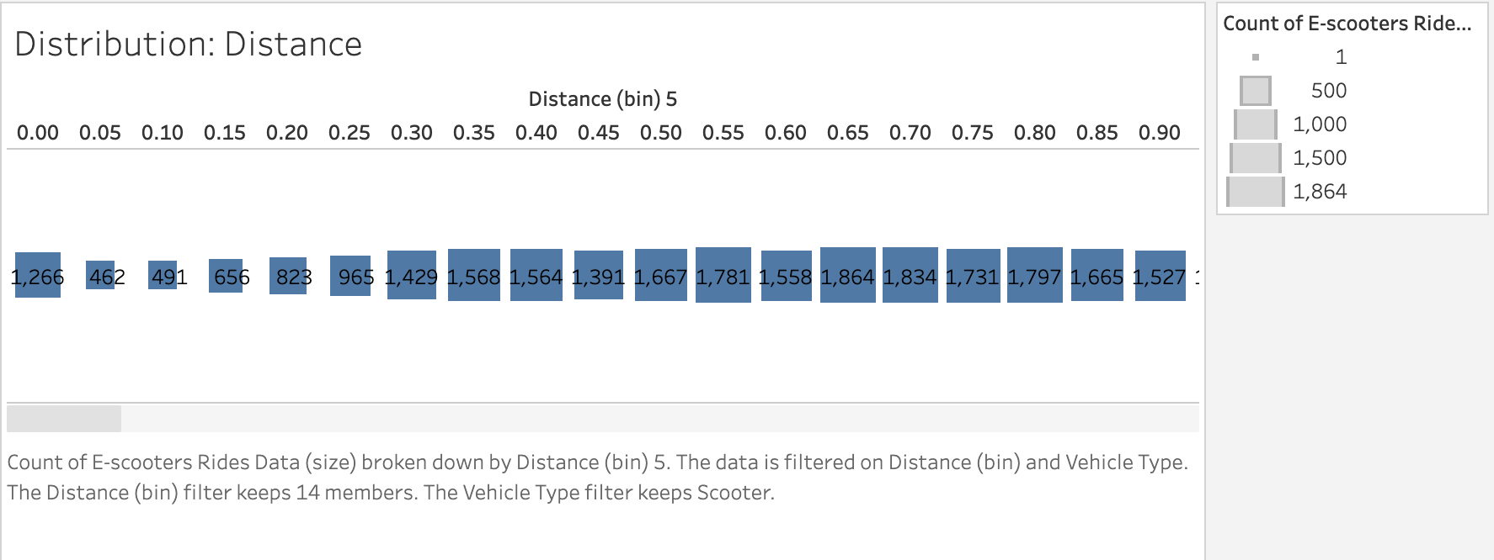
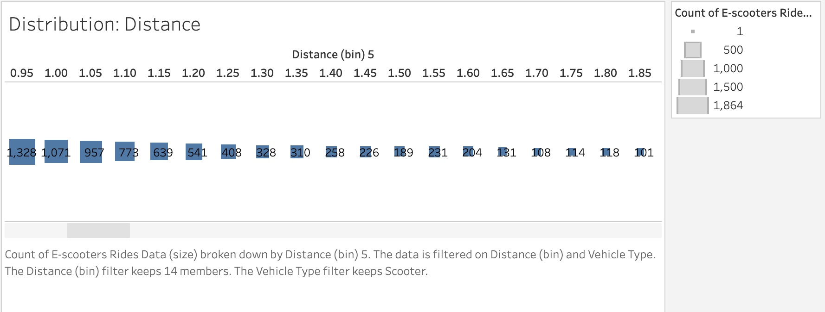
Distance
Count of scooter rides (size) broken down by Distance (bin) 5. The data is filtered on Distance (bin). The Distance (bin) filter keeps 14 members.

Slide 11
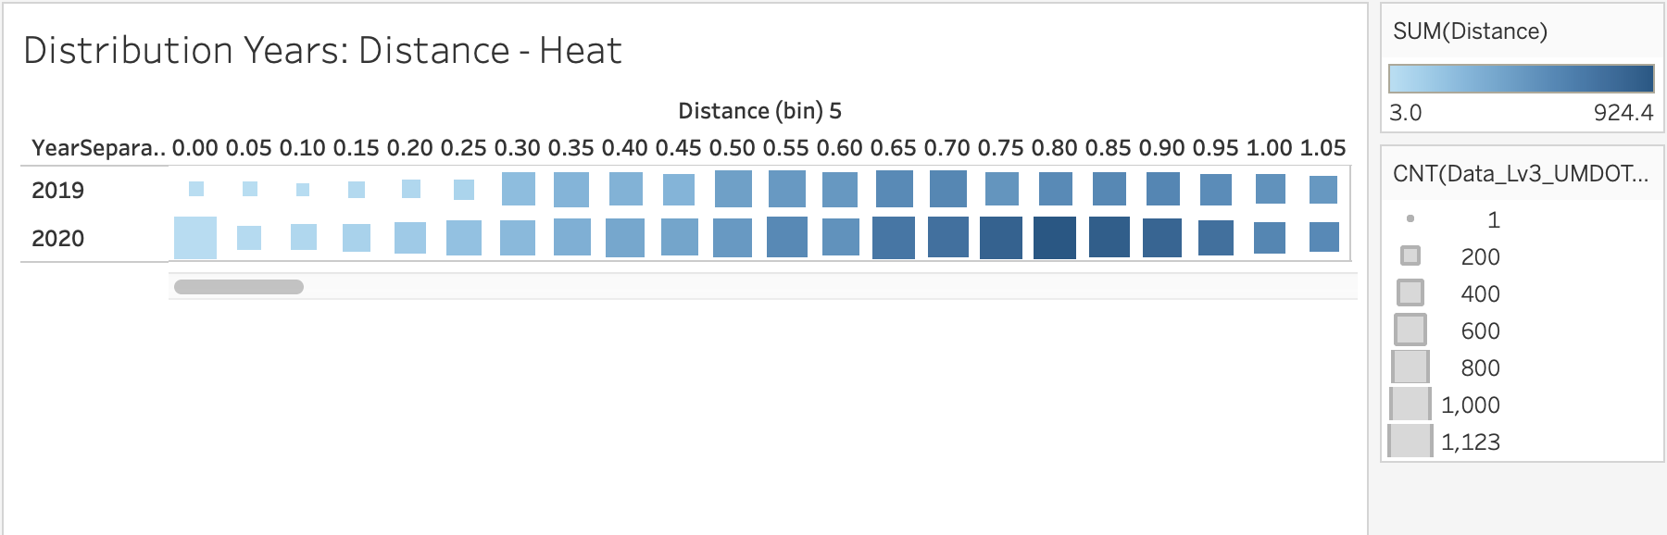
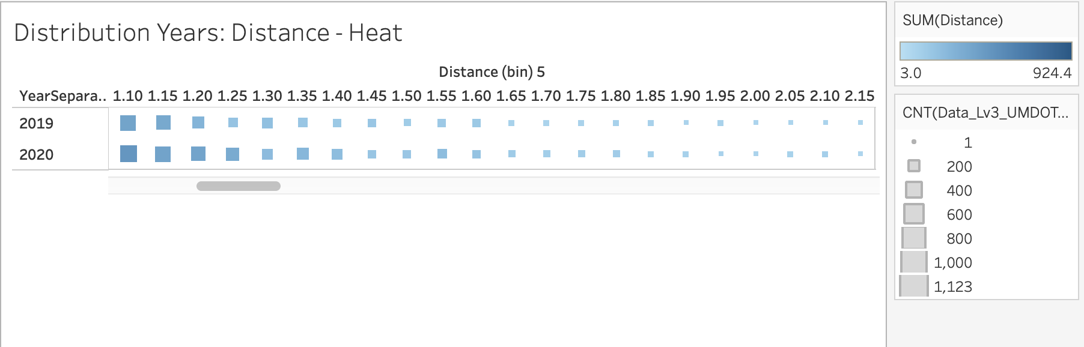
Distance/Years
Sum of Distance (color) and count of E-scooters Ride Data (size) broken down by Distance (bin) 5 vs. YearSeparation. The data is filtered on Distance (bin) which keeps 14 members.

Slide 12
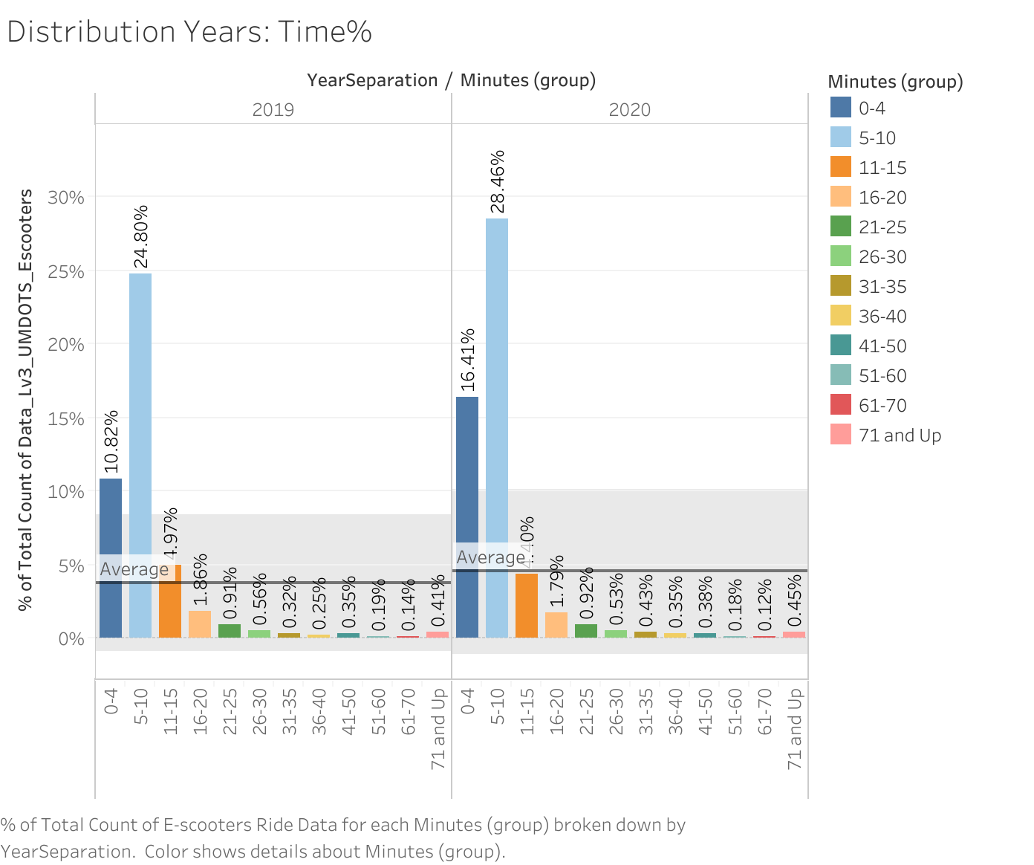
Time/Years
% of Total Count of E-scooters Ride Data for each Minutes (group) broken down by Year. Color shows details about Minutes (group).

Slide 13
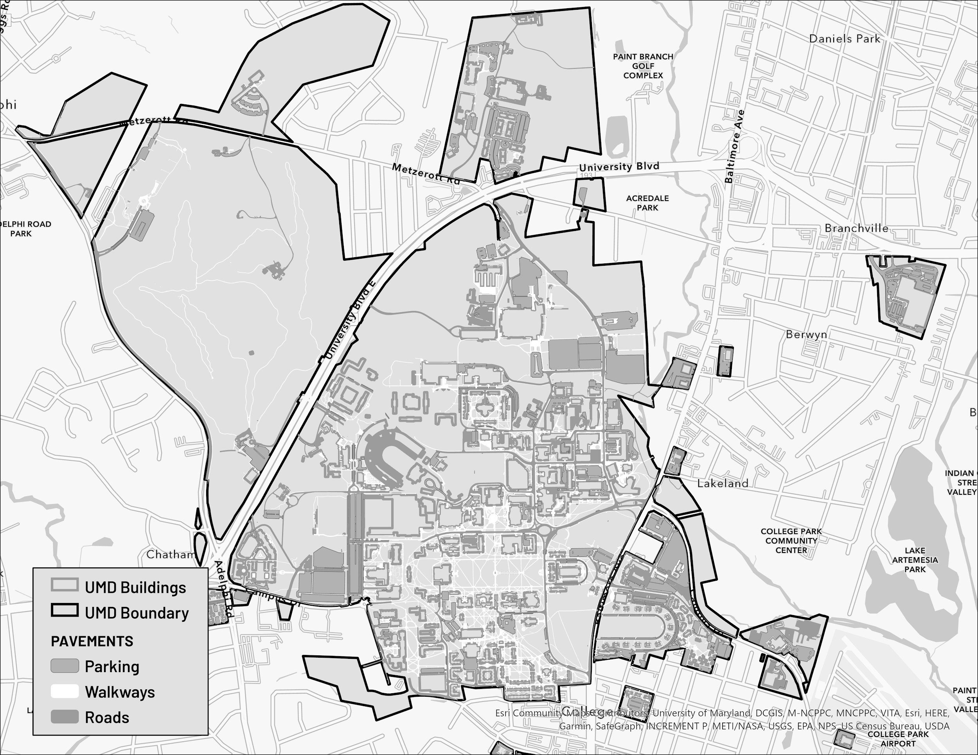
Campus Map
LEGEND
Notes:
campus map we made with the shapelayer files
used this as the foundation for our following map visualizations
shows buildings, boundary, parking, walkways, roads

Slide 14
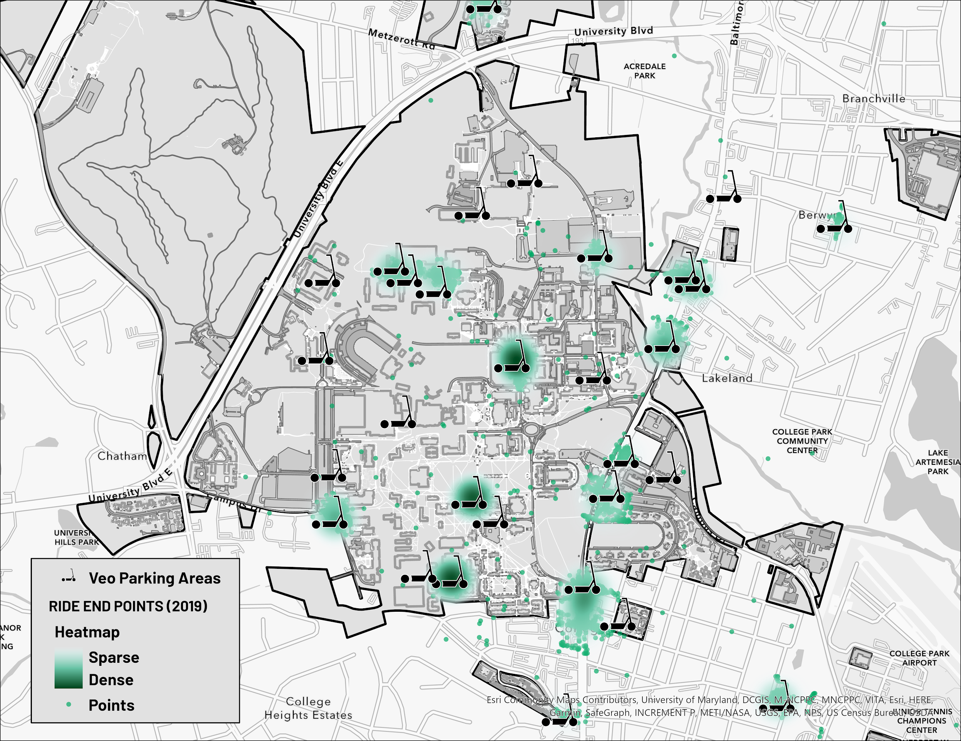
Heatmap (2019)
LEGEND
Notes:
2019 end points concentrated around scooter stations
barely any points on the streets or outside campus
less rides in 2019

Slide 15
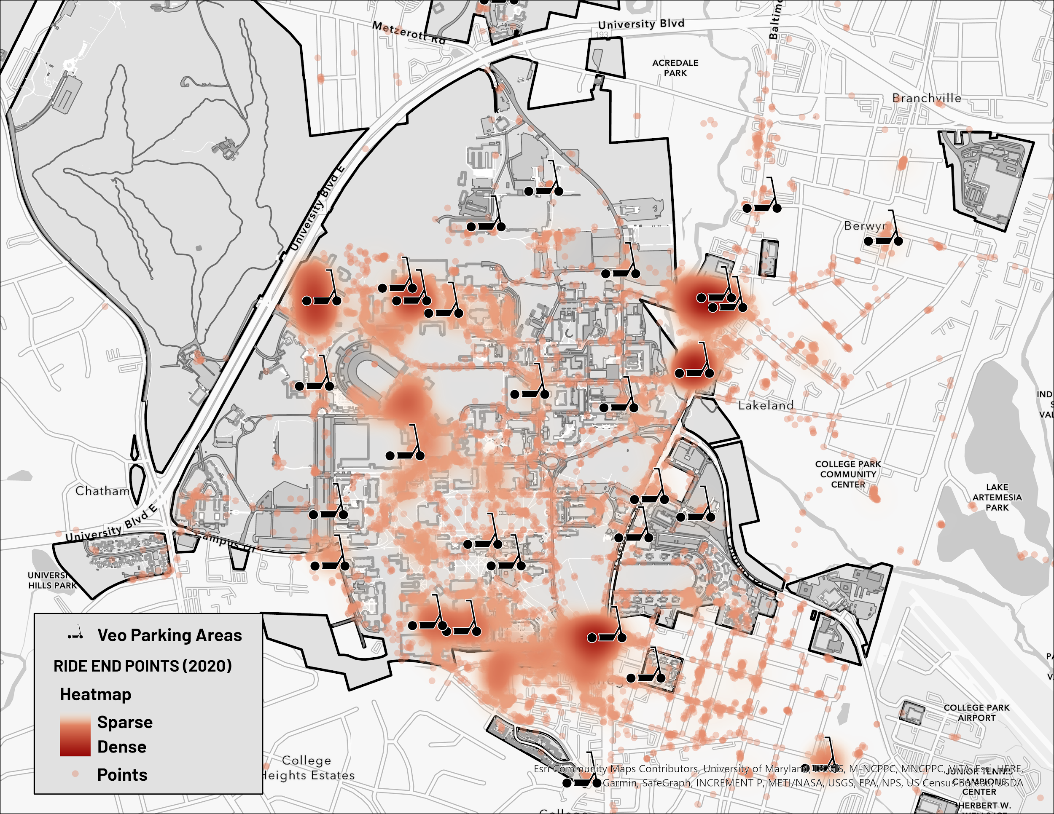
Heatmap (2020)
LEGEND
Notes:
2020 points much more scattered
heatmap is more dense
2020 had more rides than 2019

Slide 16
VISUALIZATION & FOCUS ANALYSIS

Slide 17
ArcGIS
UMD Campus map
Our datasets:
UMD VeoParking Areas
Shuttle-UM Bus stop locations
WMATA bus stop locations on campus
Notes:
Talk about why our data

Slide 18
INVESTIGATE HOW OFTEN E-SCOOTERS ARE USED TO COMMUTE TO BUS STOPS ON CAMPUS

Slide 19
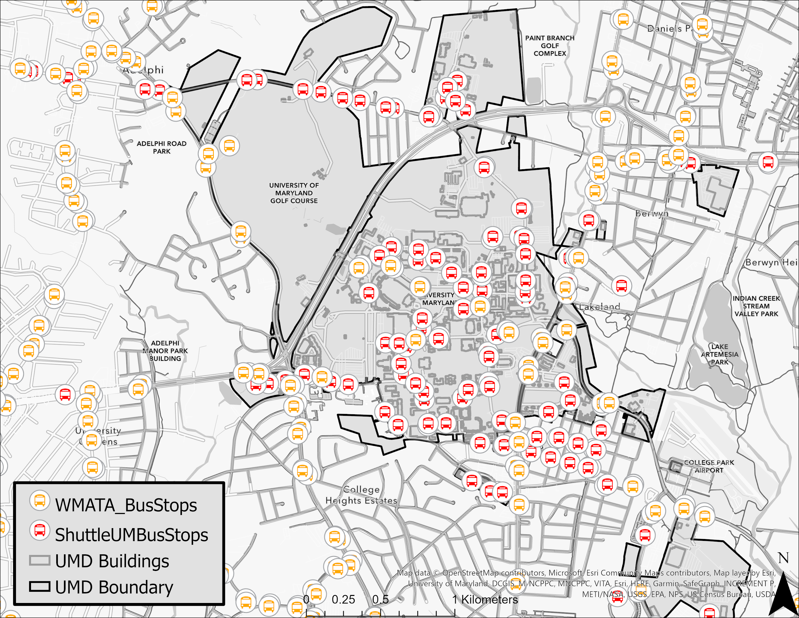
Shuttle-UM & WMATA Bus Stops
Notes:
We begin by showing the bus stops on the campus map.
WMATA busses are shown in yellow and UMD buses in red.

Slide 20
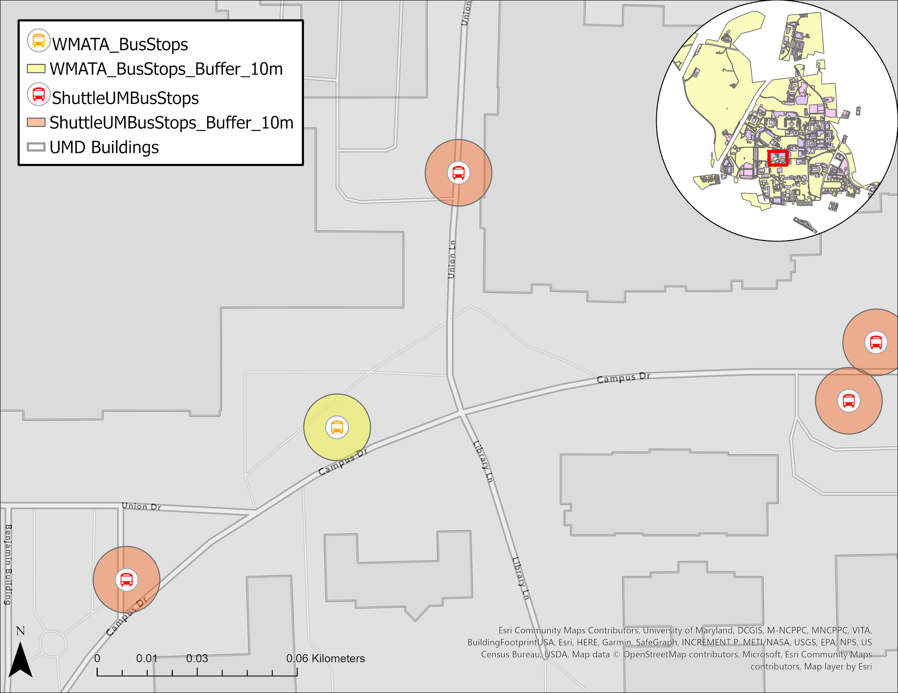
10 Meters Buffer Around Stops
Notes:
After displaying the stops, we needed to establish a system to identify the rides that ended at the bus stops.
We choose a buffer system around the bus stops. The idea was that all the rides that ended inside that buffer would be considered to be a ride taken to the bus stop.
The challenge then was to decide how wide the buffer should be. Because we do not want to overshoot by including rides that ended far from the stops or undershoot and not include enough rides.
After experimenting with 5, 10, 20, and 50 meters buffers, we choosing 10 meters because it was the most reasonable, and also based on the average walking distance of an adult (around 1.3 meter/second), it would take a maximum of 10 second to walk to the stop after parking the scooter.
A better way would be to calculate the walking distance based on street data using a network map. and also take into account nearby Veoride parking stations. But we did not have access to a network map of UMD, and we had time to constraint.

Slide 21
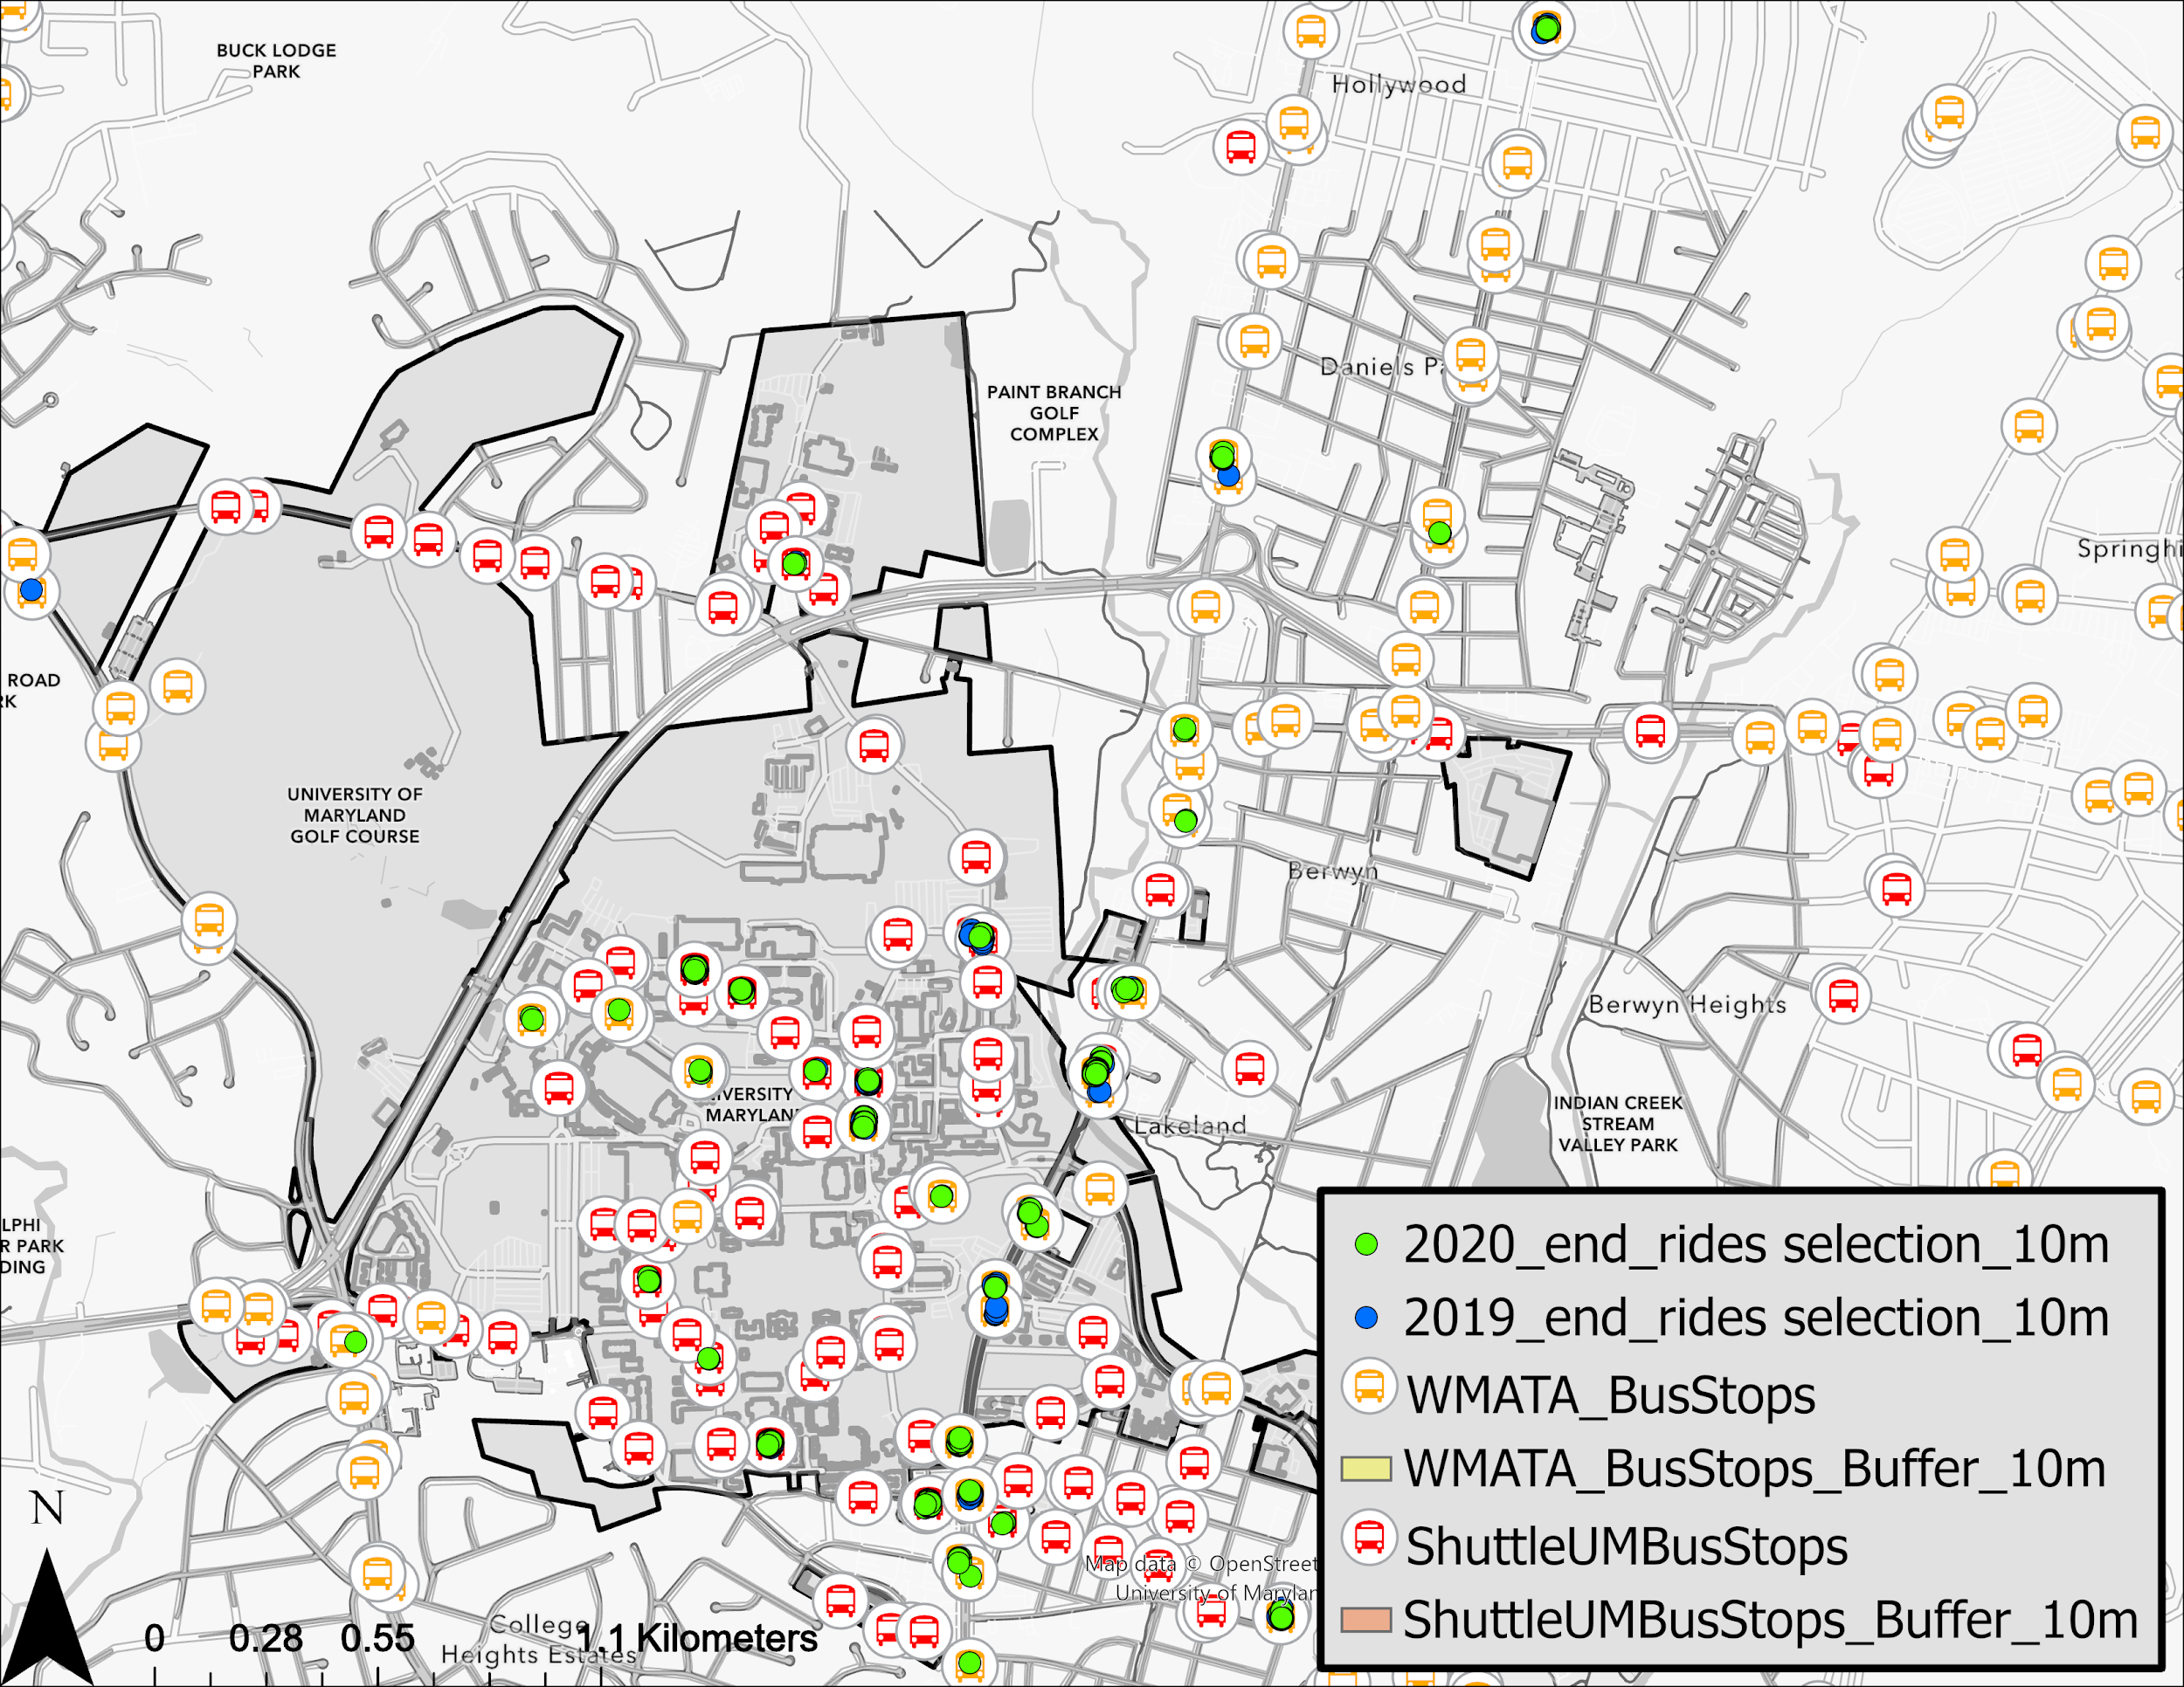
Rides Taken to Bus Stops
Notes:
Here, after the buffer, we show the rides the ended at the bus stops.
2019 rides are in blue, and 202 rides are in green.

Slide 22
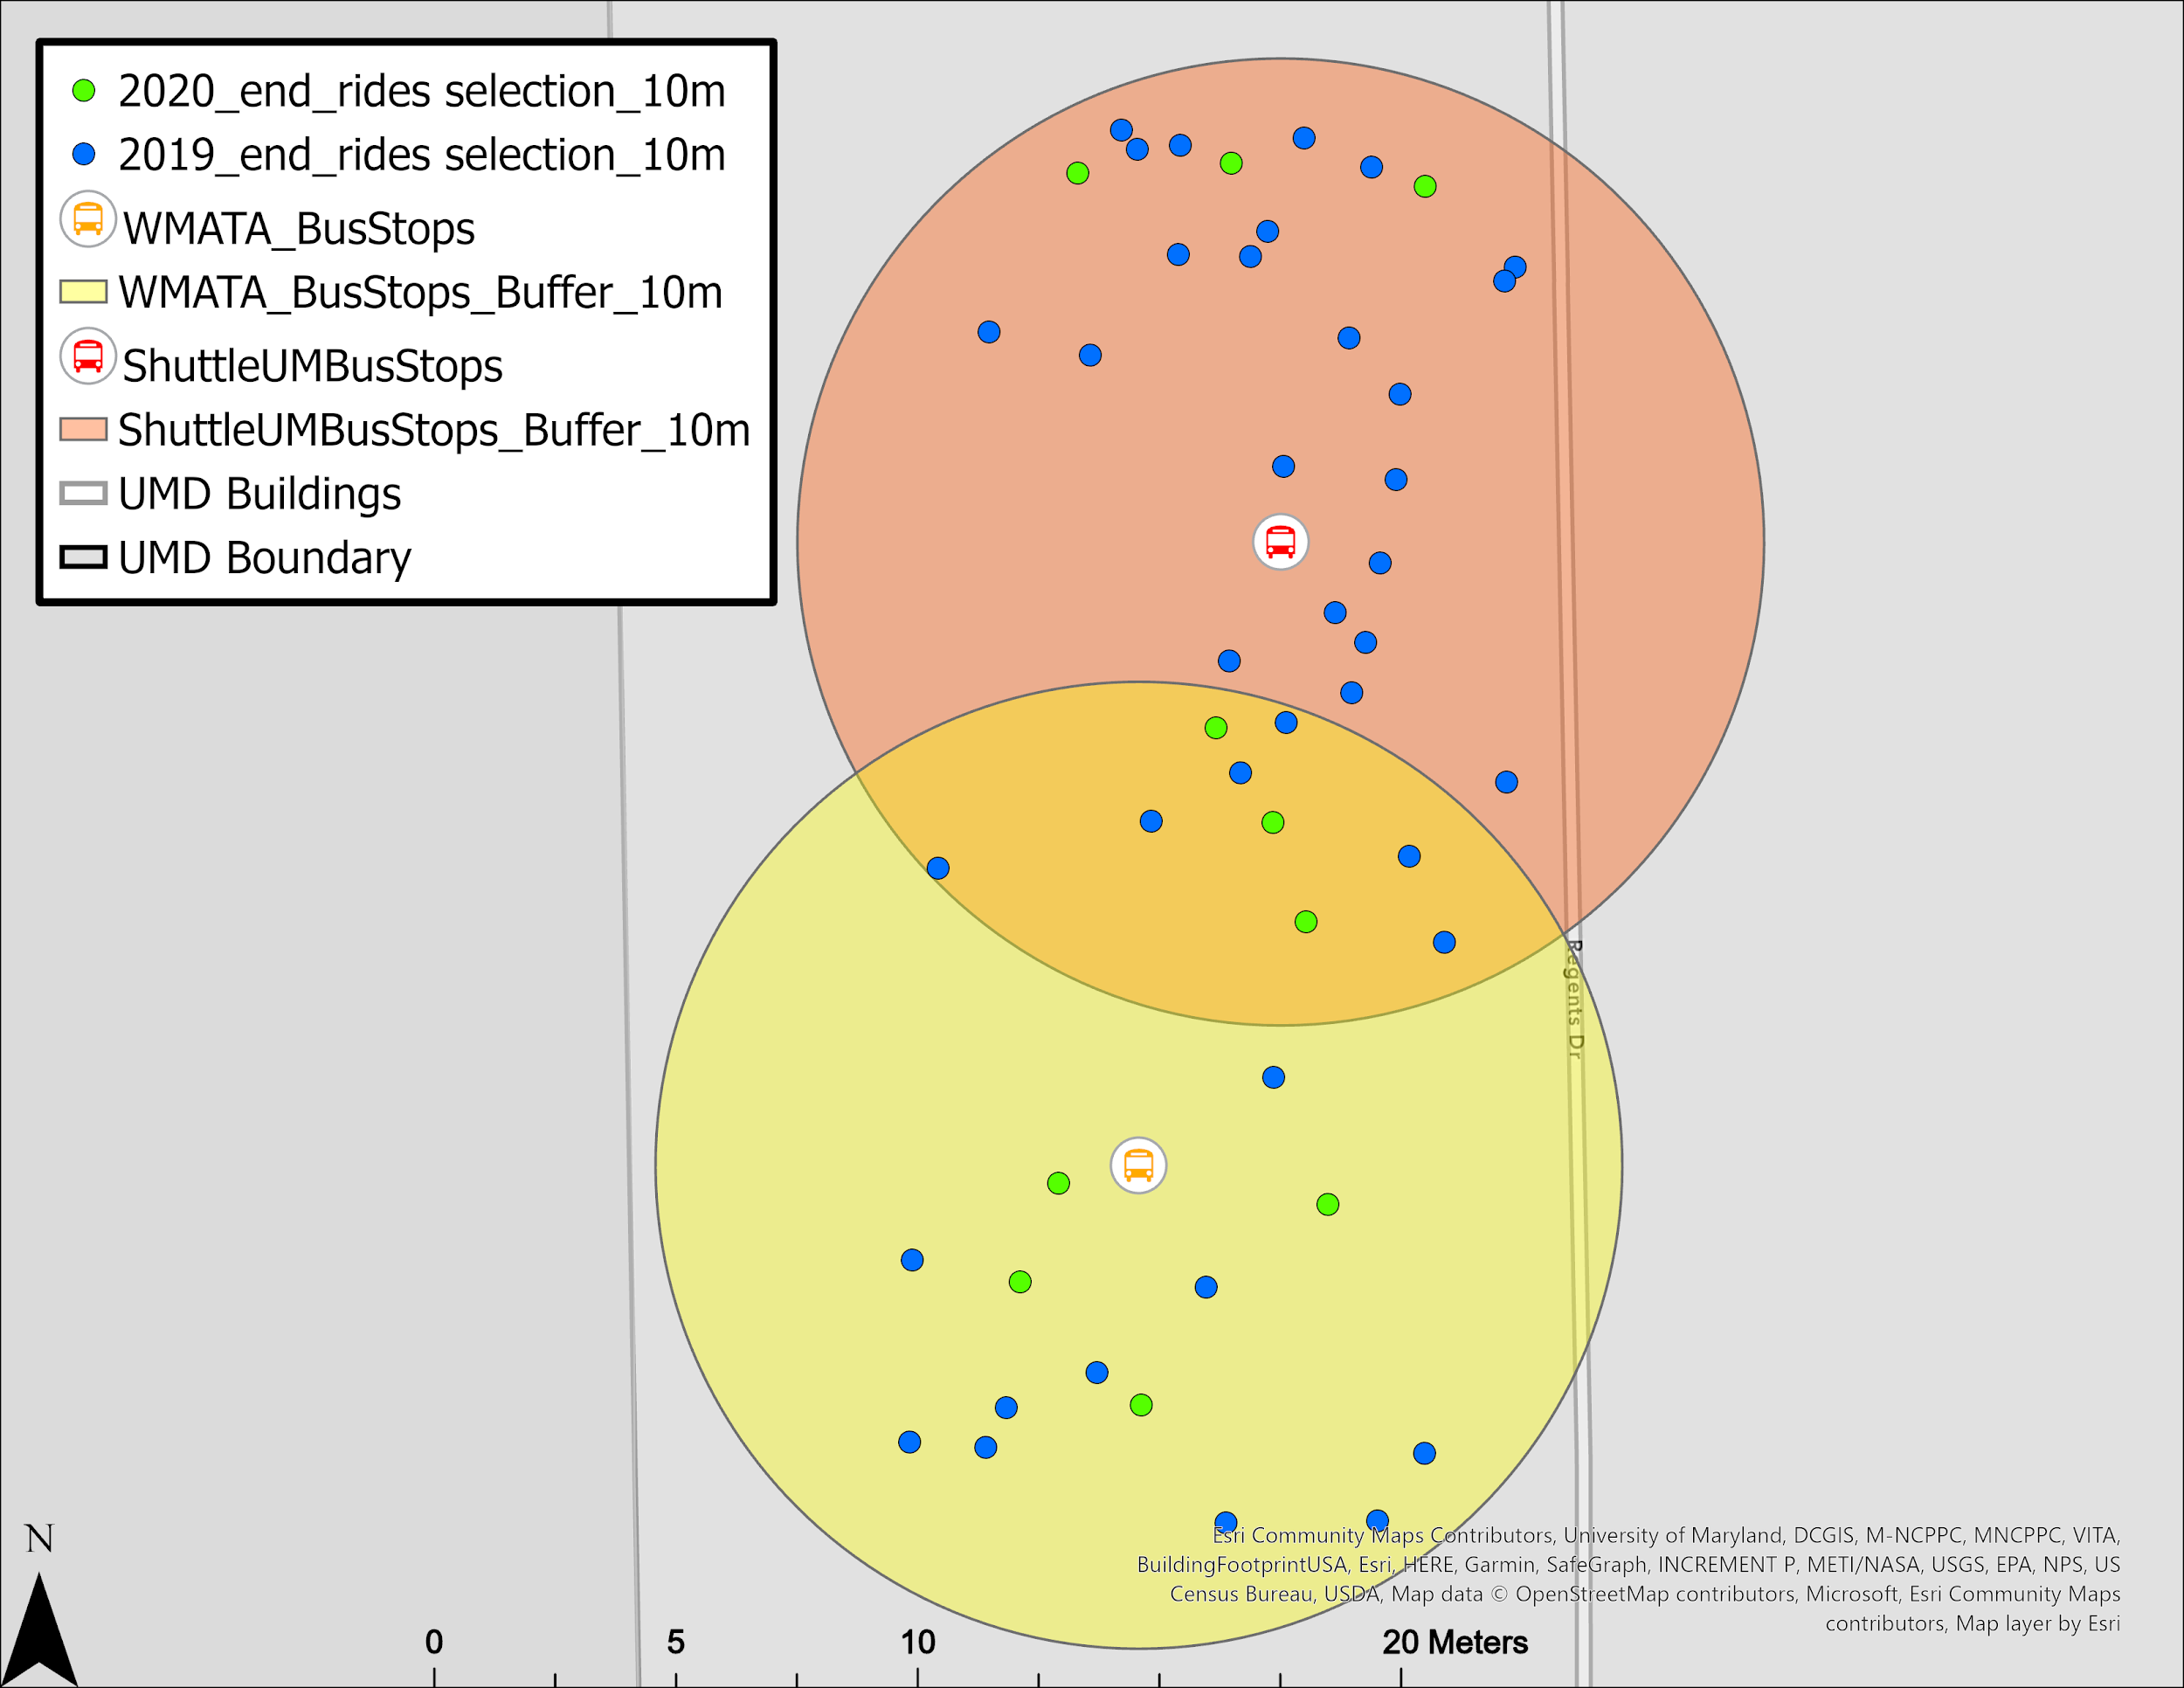
Example Bus Stops with End Rides
Notes:
Here we zoom into two of the stops.
Again in blue, we have 2019 rides, and in green, 2020 rides.

Slide 23
Findings
Total Rides: 34555
2019 Total Rides: 14391
2020 Total Rides: 20164
Total Rides to Bus Stops: 1666 / 4.8% of total rides
2019 Total Rides to Bus Stops: 793 / 5.5% of 2019 total rides
2020 Total Rides to Bus Stops: 873 / 4.3% of 2020 total rides
Notes:
As we saw previously, there are 34555 rides in total. Of which 14391 are from 2019 and 20164 are from 2020.
Our investigation of the usage of the e-scooters to bus stations found a total of 1666 rides ended at a bus stop. of which 793 are from 2019 - that is about 5.5% of all 2019 rides
and 873 are from 2020 - about 4.3% of all 2020 rides.

Slide 24
Findings
2019
2020
WMATA Bus Stops:
Total Rides: 544 / 69% of 2019 rides to bus stops
271 Rides to “Baltimore AVE + Lakeland”
99 Rides to “Baltimore AVE + Knox RD”
47 Rides to “Baltimore AVE + Regent DR”
Shuttle-UM Bus Stops:
Total Rides: 249 / 31% of 2019 rides to bus stops
145 Rides to “South Campus Commons 1 & 2”
19 Rides to “Regent Drive + Stadium DR”
WMATA Bus Stops:
Total Rides: 511 / 59% of 2020 rides to bus stops
351 Rides to “Baltimore AVE + Lakeland RD”
73 Rides to “Baltimore AVE + Regent DR”
Shuttle-UM Bus Stops:
Total Rides: 362 / 41% of 2020 rides to bus stops
248 Rides to “La Plata-Hall”
51 Rides to “University View”
28 Rides to “College Park Shopping Center”

Slide 25
Conclusion: Bus Stop Usage
Total Rides to Bus Stops: 1666
2019 Total Rides to Bus Stops: 793
2020 Total Rides to Bus Stops: 873
WMATA Bus Stops Combined Rides:
Total Rides: 1055 / 63% of All rides to bus stops
UMD Shuttle Bus Stops Combined Rides:
Total Rides: 611 / 37% of All rides to bus stops

Slide 26
Conclusion: Bus Stop Usage
Total Rides to Bus Stops: 1666
2019 Total Rides to Bus Stops: 793
2020 Total Rides to Bus Stops: 873
WMATA Bus Stops Combined Rides:
Popular Stops
622 Rides to “Baltimore AVE + Lakeland”
120 Rides to “Baltimore AVE + Regent DR”
Shuttle-UM Bus Stops Combined Rides:
Popular Stops
248 Rides to “La Plata-Hall”
145 Rides to “South Campus Commons 1 & 2”
51 Rides to “University View”
28 Rides to “College Park Shopping Center”
Notes:
La Plata-Hall and South Campus Commons 1&2 College Park Shopping Center University view Highly influenced by the pandemic.

Slide 27
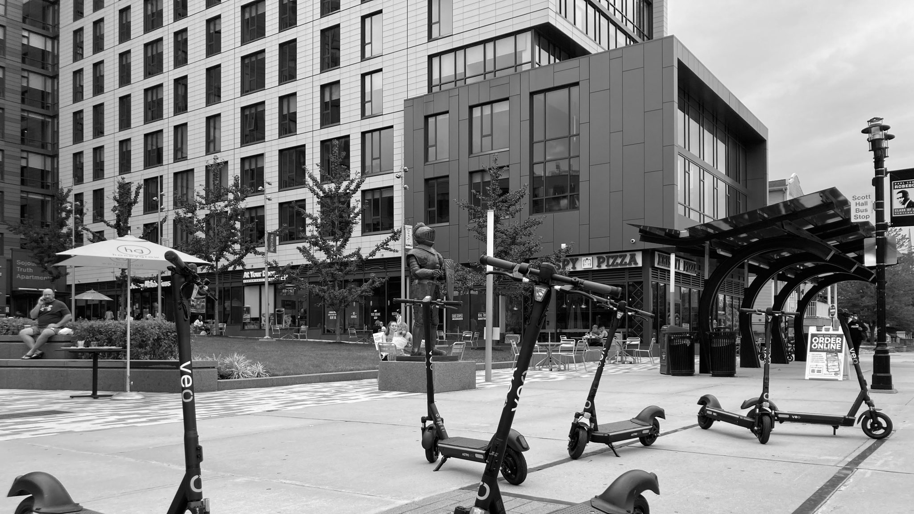
INVESTIGATE POPULAR E-SCOOTER PARKING AREAS

Slide 28
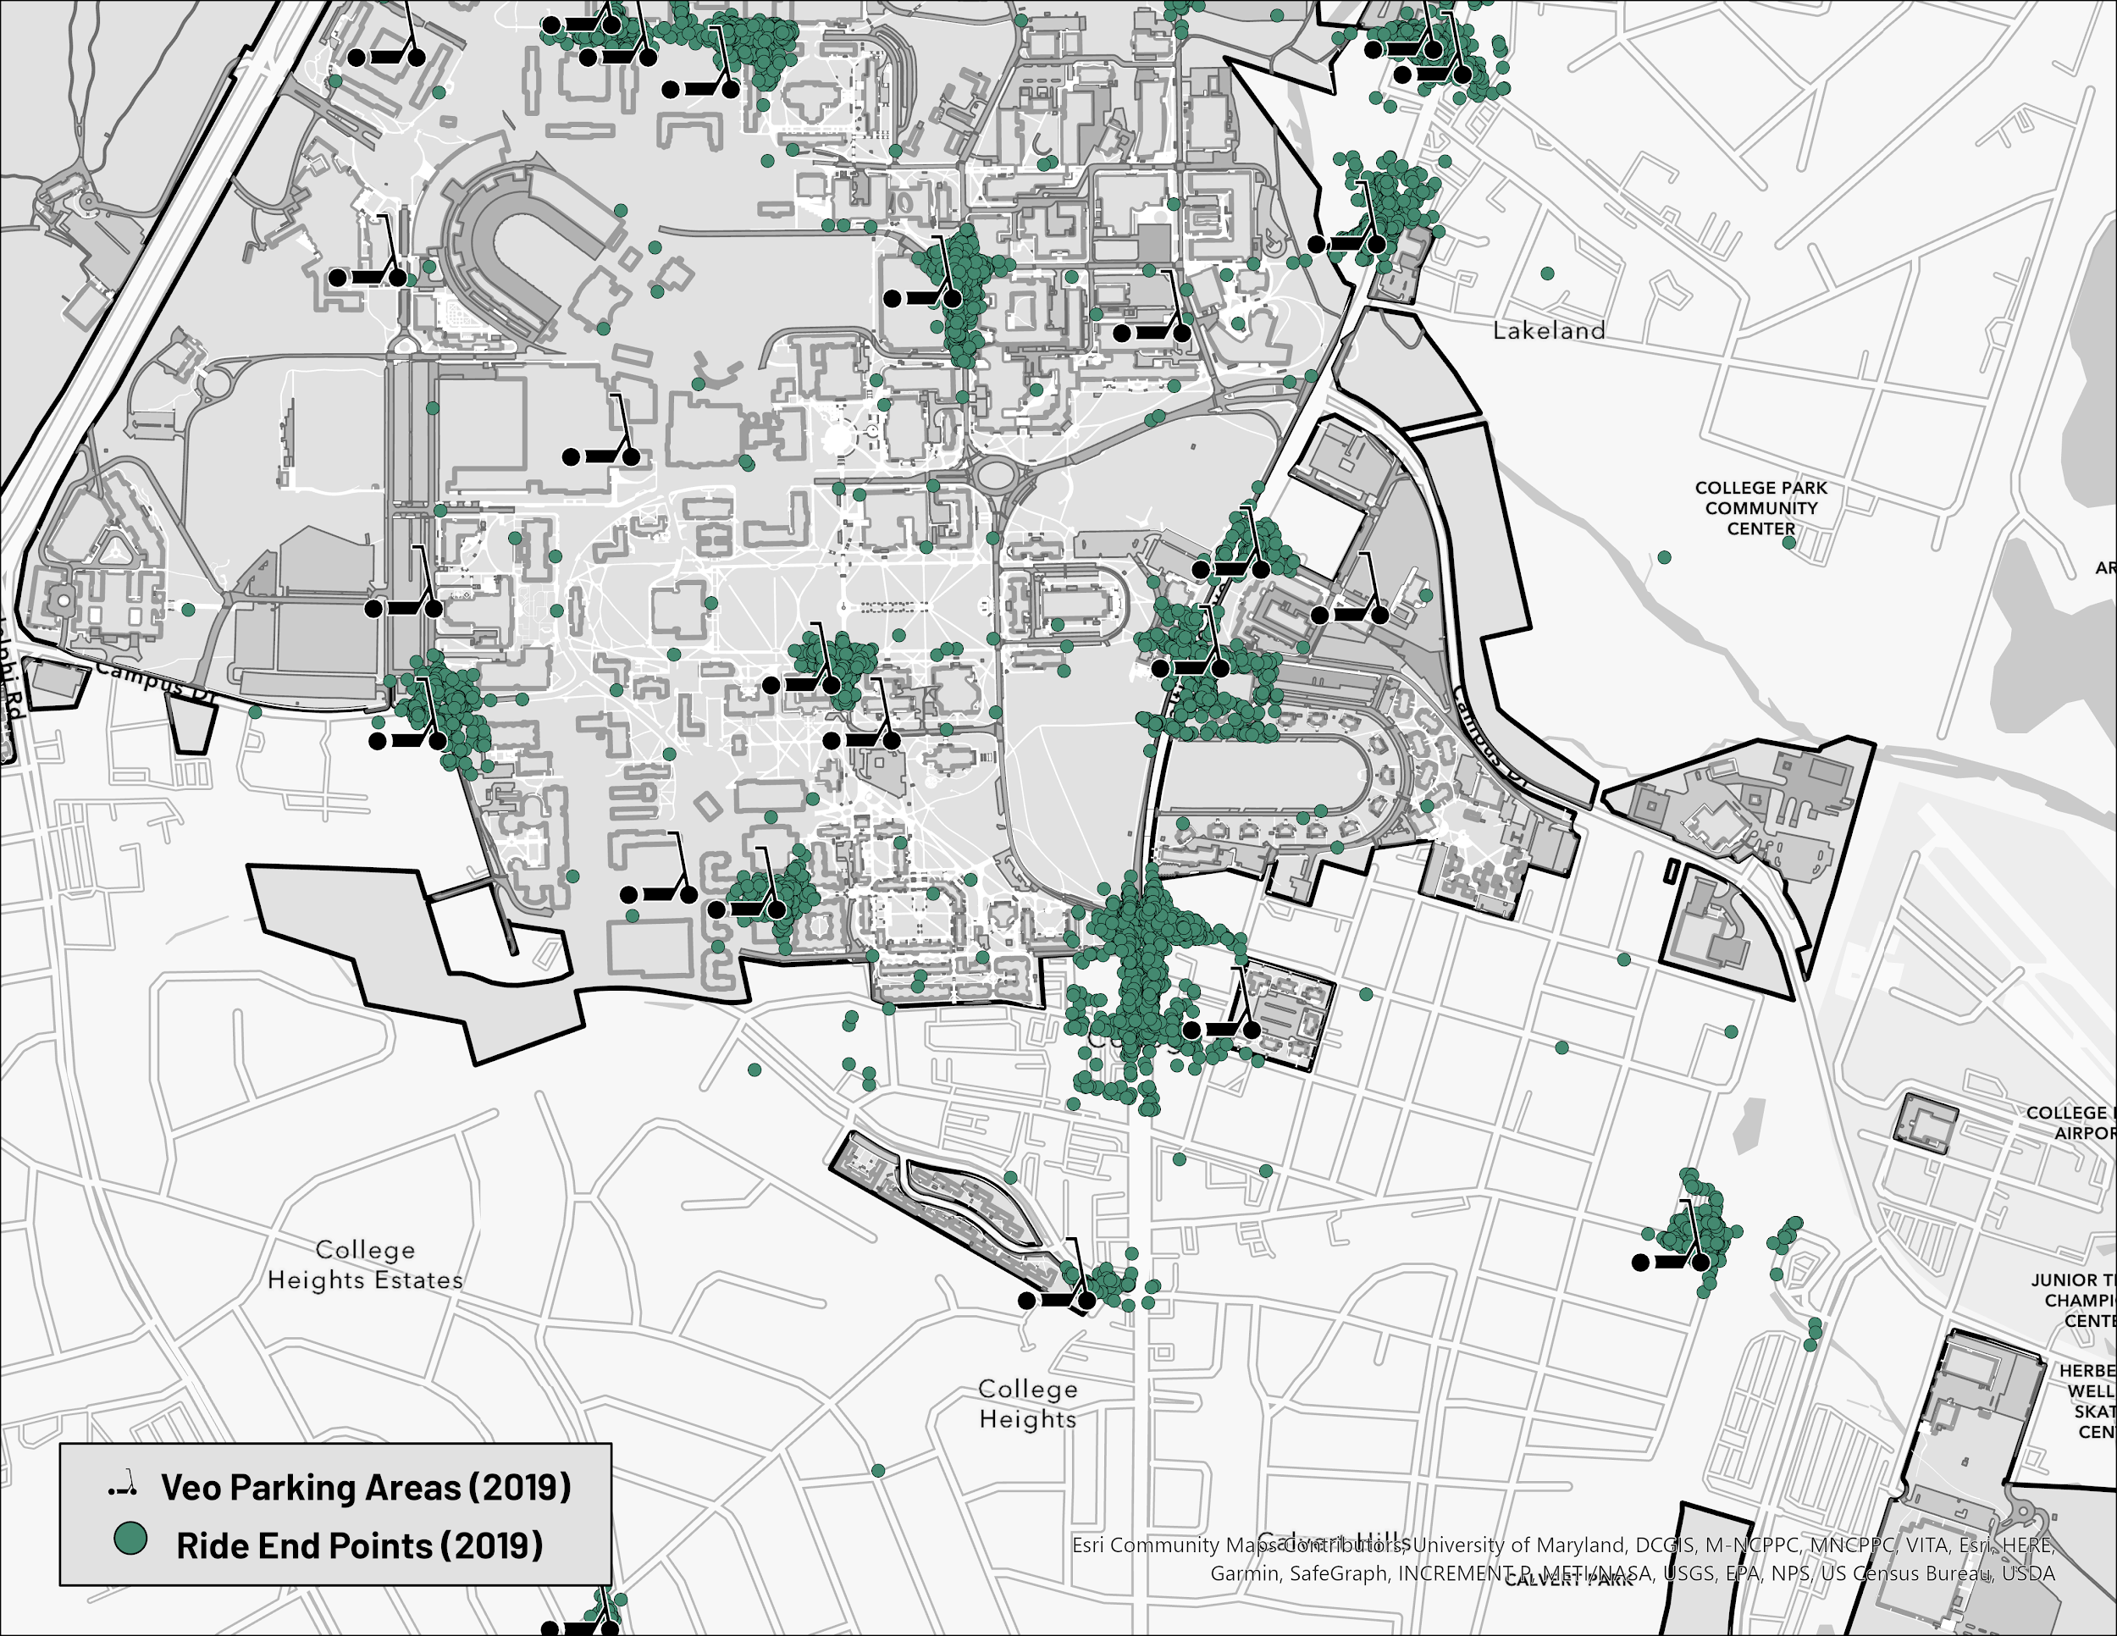
Target Location (2019)
The Target on Baltimore Ave. in College Park had a high concentration of rides in 2019, but there was no scooter station (at the time).
LEGEND

Slide 29
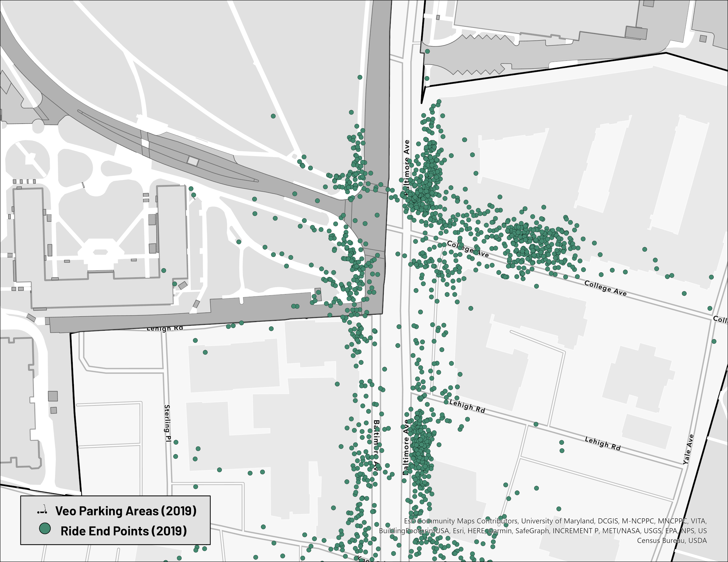
Target Location (2019)
The Target on Baltimore Ave. in College Park had a high concentration of rides in 2019, but there was no scooter station (at the time).
Target
LEGEND

Slide 30
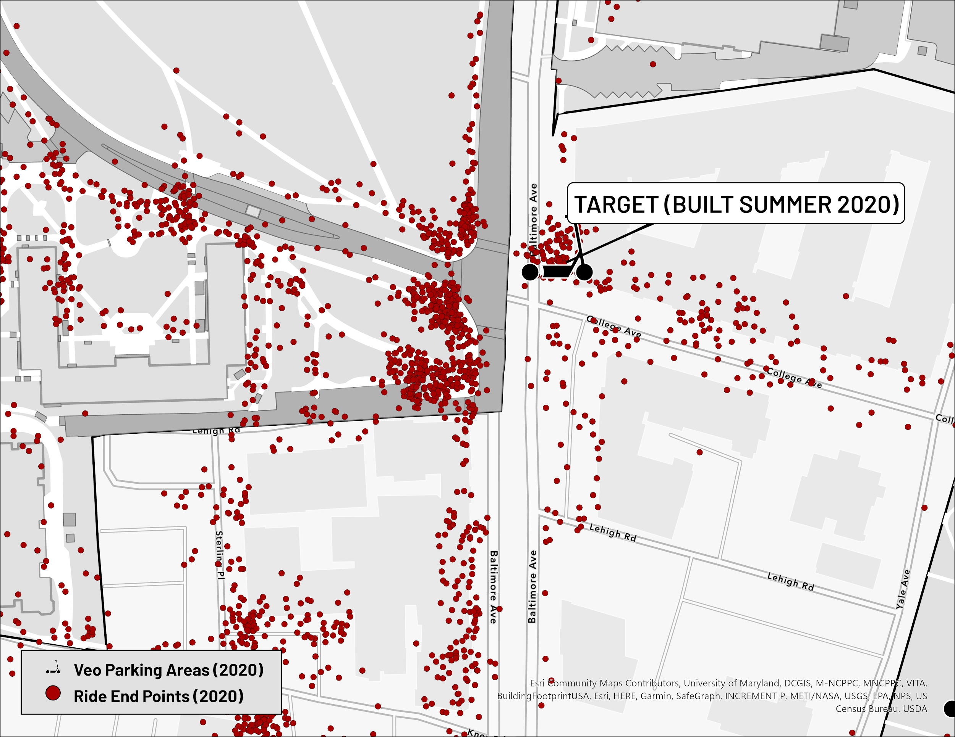
Target Location (2020)
VeoRide added a “Target” scooter station to this location in Summer 2020. After finding this in the data, we wanted to investigate what other areas need a Veo Parking area added based on their popularity among E-scooter riders.
Target
LEGEND

Slide 31
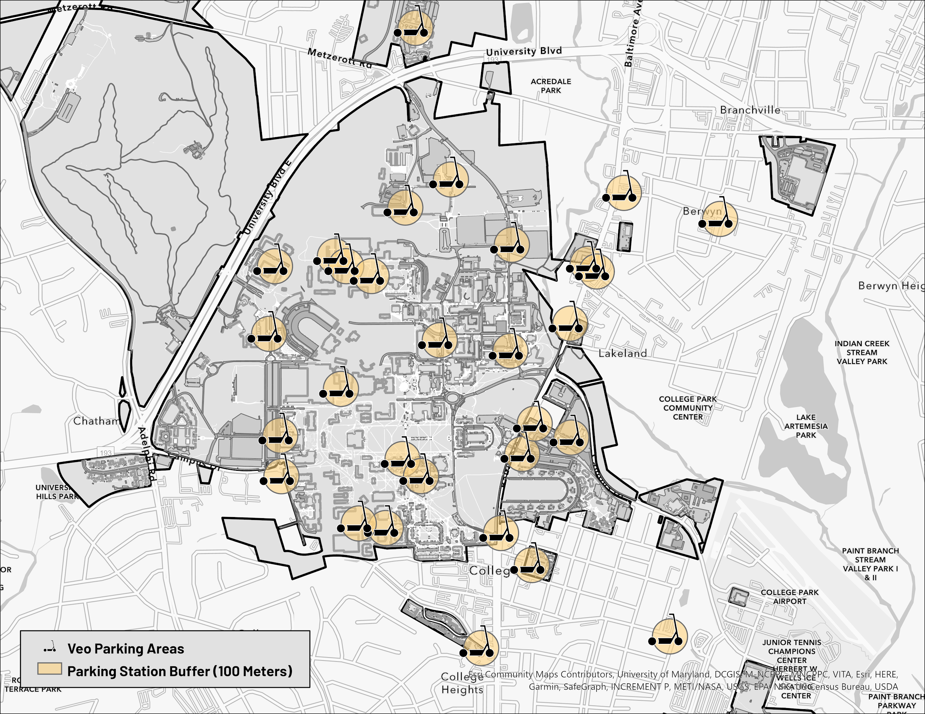
Distance Buffers
We created buffers of 100 meters for all the Veo Parking Areas. This creates a circle of 100 meters around each station, so we could filter points based on this distance.
LEGEND

Slide 32
Distance Buffers
Using the buffers, we found end points (from both 2019 & 2020) that did and did not fall within this 100 meter distance.
LEGEND

Slide 33
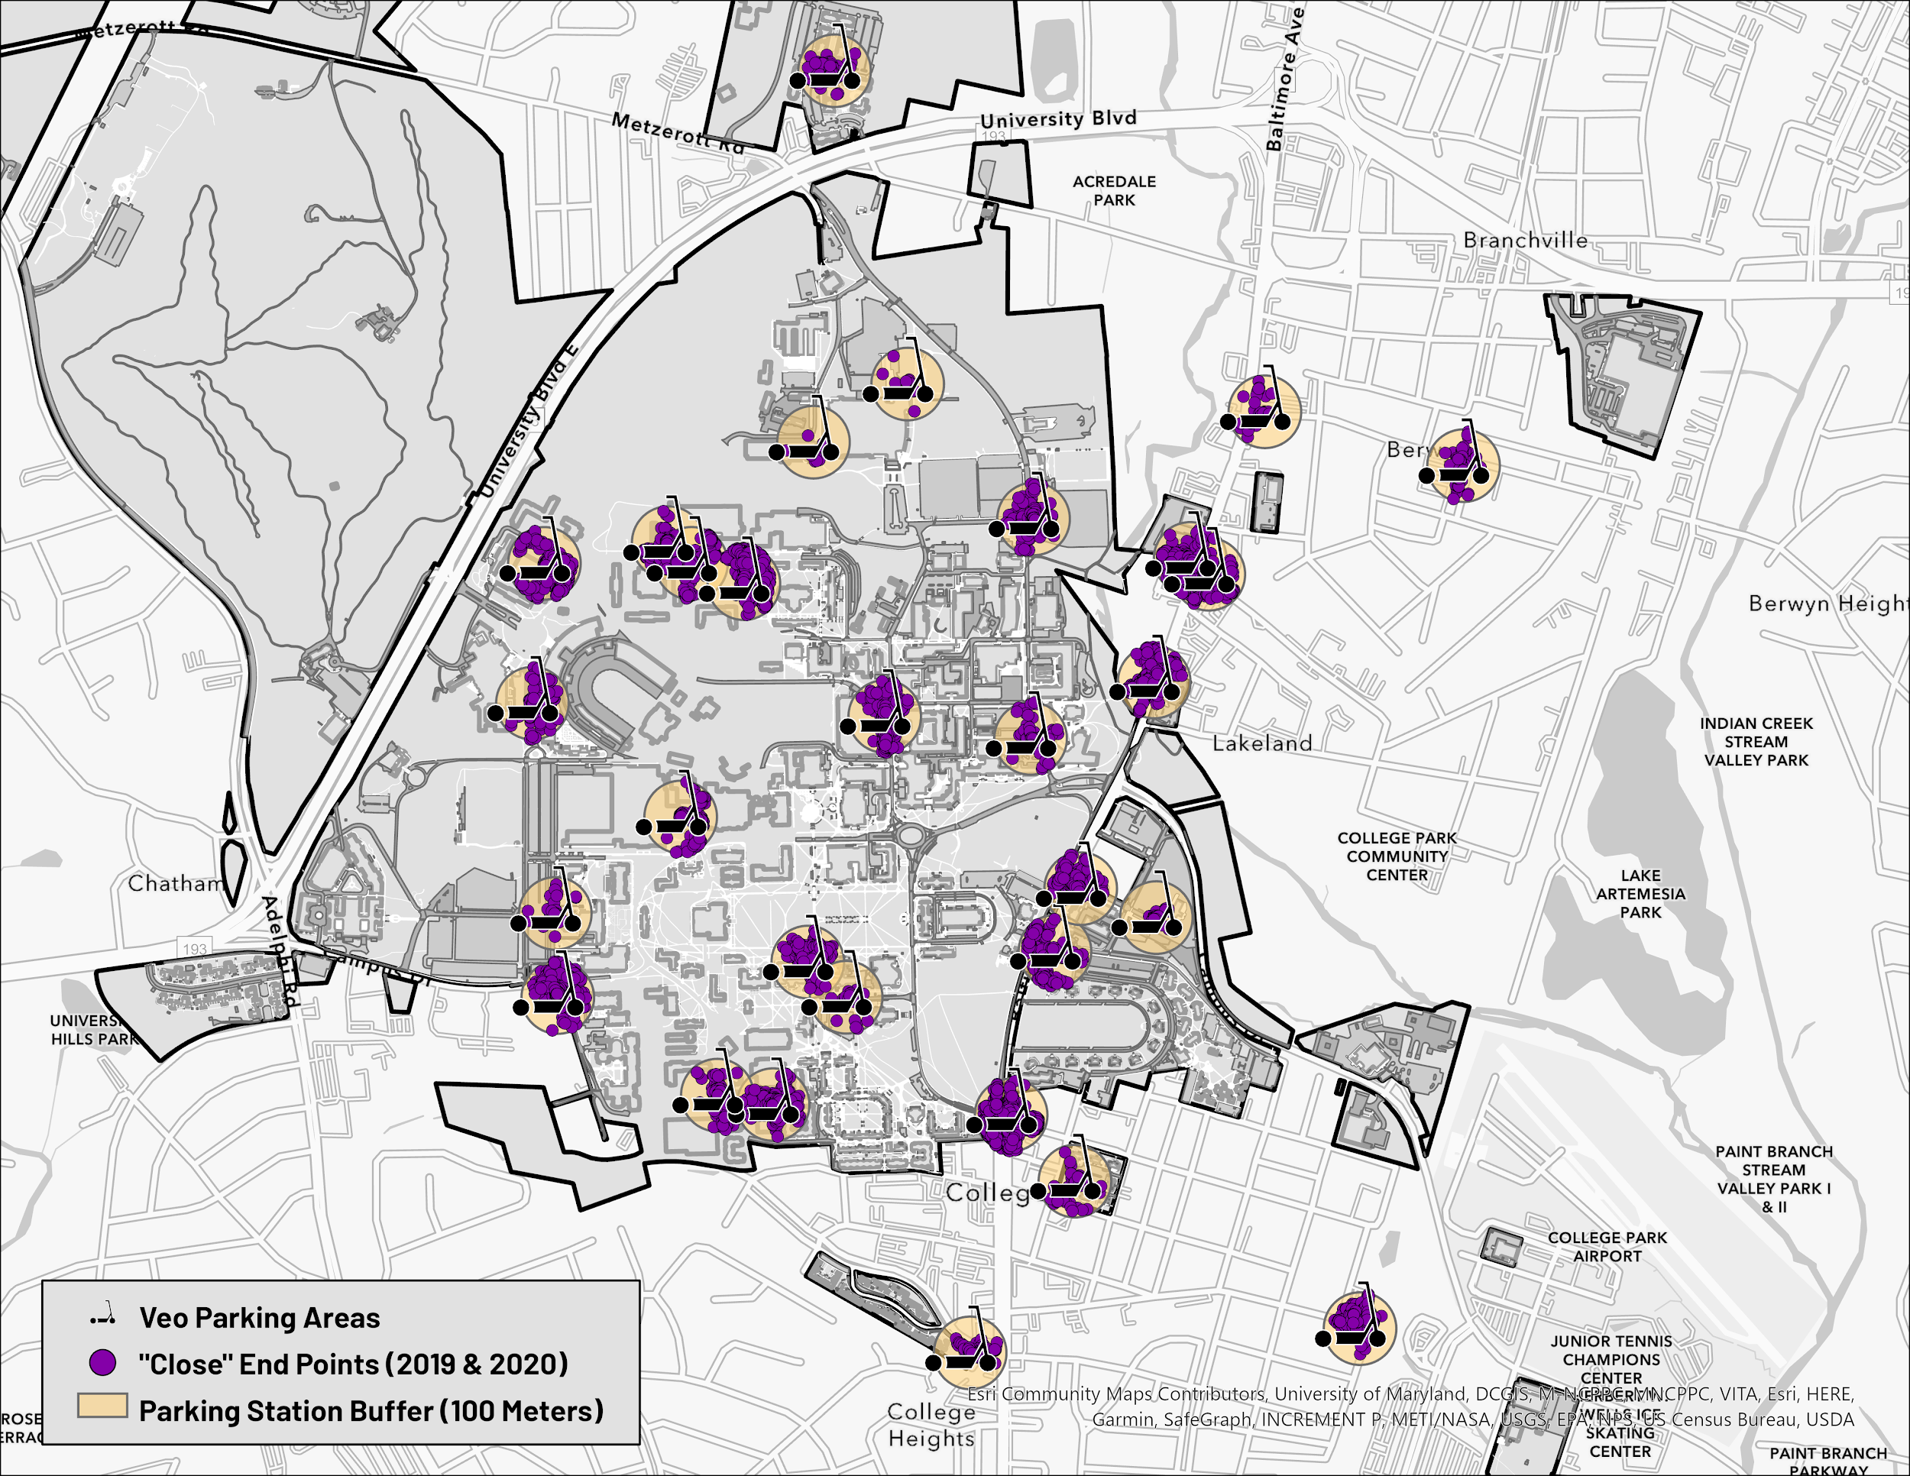
Close End Points
Total count of “close” scooter rides: 20,193.
The total amount of UMD scooter stations: 37
Average amount of rides that are close to a scooter parking area: 546
LEGEND
LEGEND

Slide 34
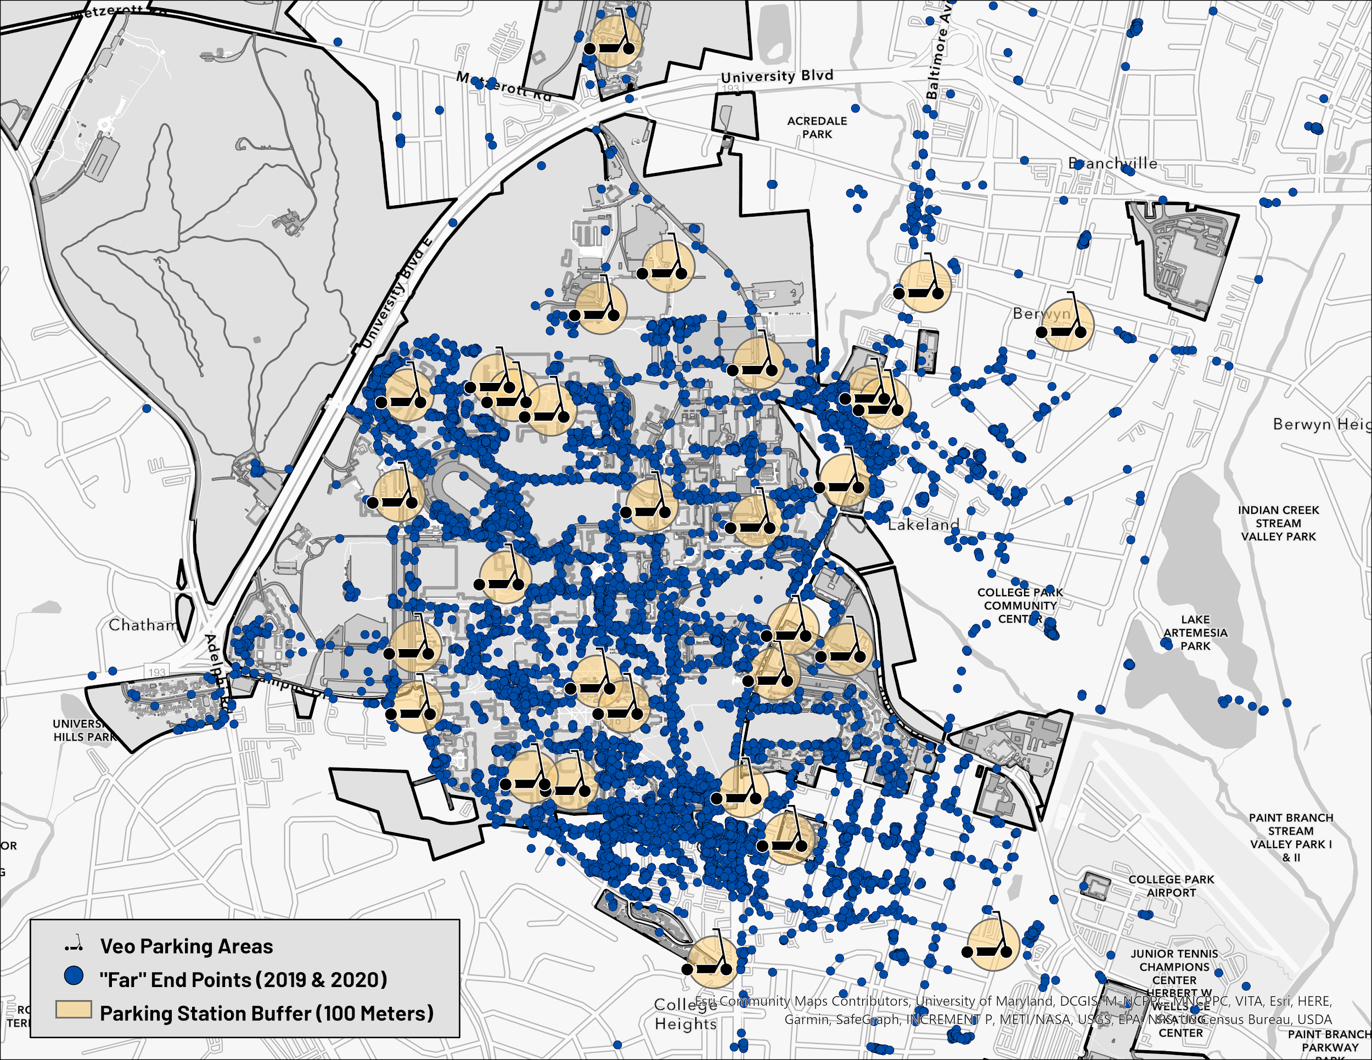
Far End Points
These points are more than 100 meters away from a Veo Parking station. They are the “far” ride end points.
We used these far end points to conduct density-based clustering to find popular areas.
LEGEND
LEGEND

Slide 35
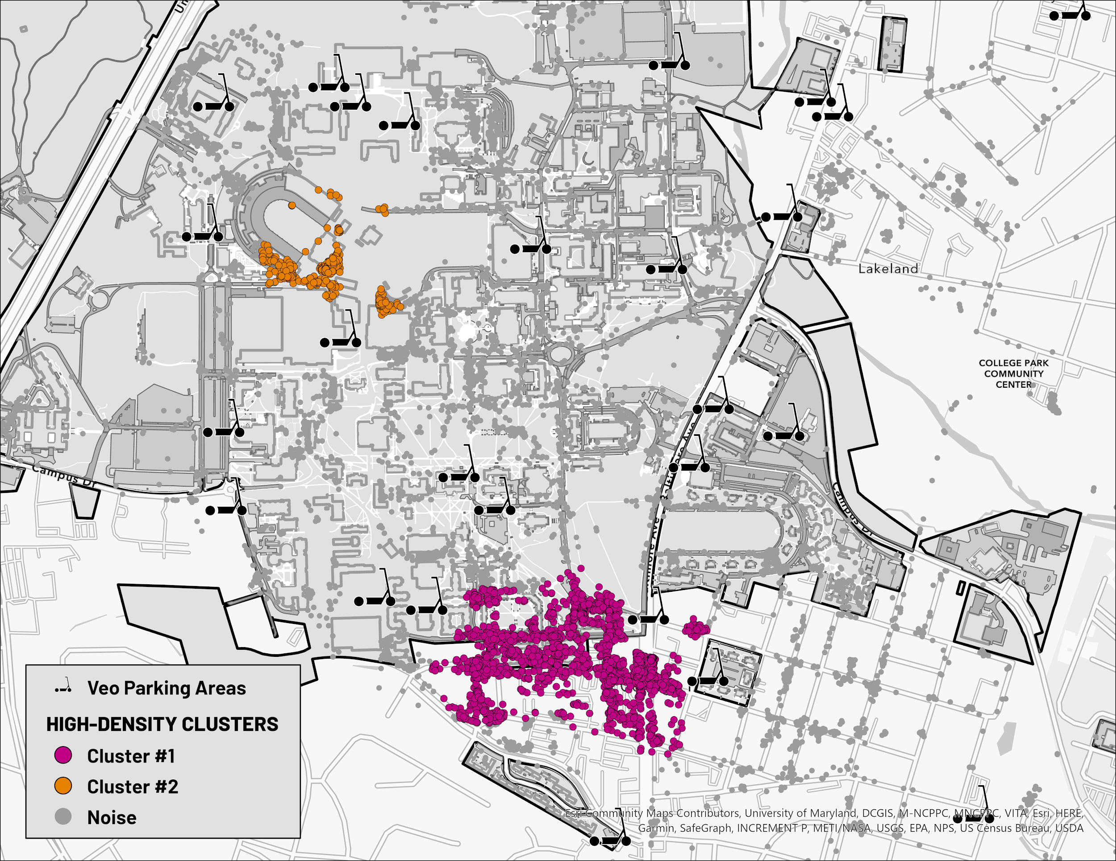
Density-Based Clustering
We used the average close rides, 546, and our chosen distance, 100 meters, to run a density-based clustering tool and find high-density areas that are far from existing scooter parking.
The tool returned two popular areas that are far from a Veo Parking area:
Cluster #1: Maryland Stadium
Cluster #2: T-Row / South Campus Commons
LEGEND

Slide 36
RECOMMENDATION

Slide 37
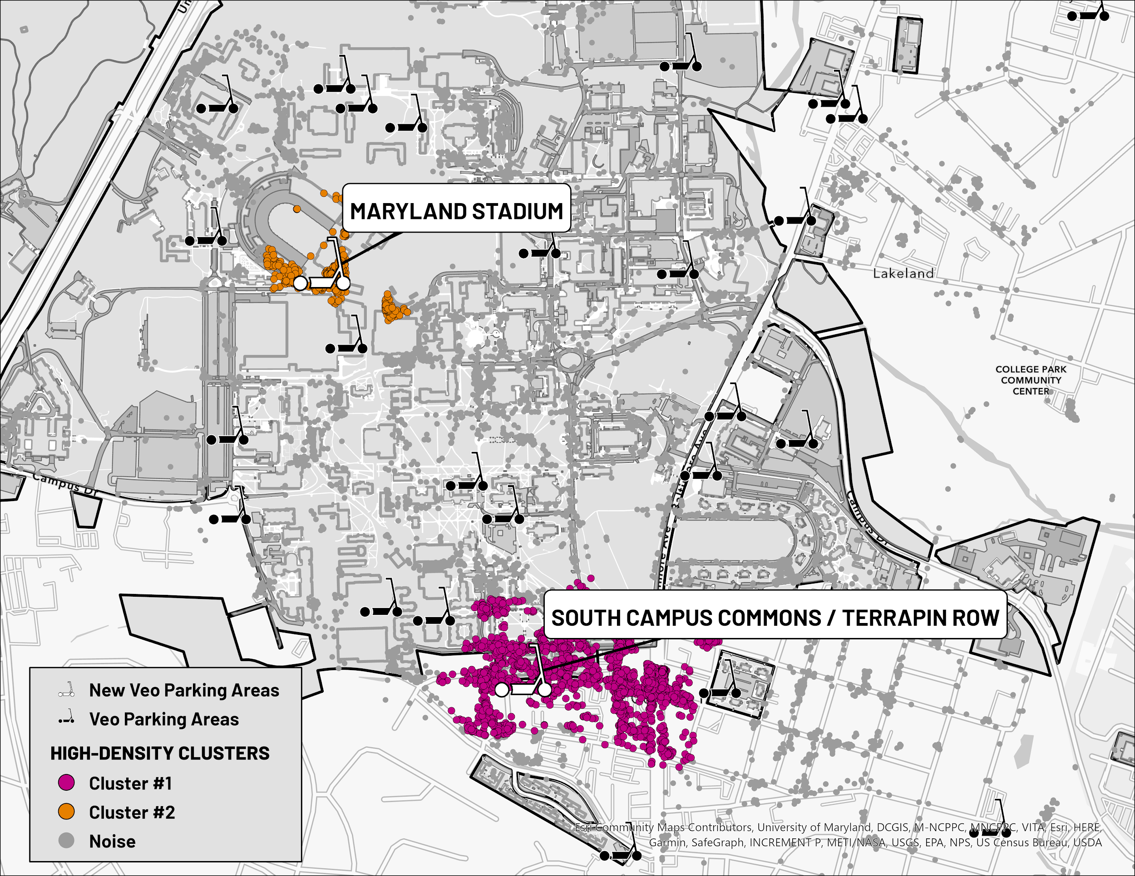
Recommendation: New Veo Parking Areas
We recommend that Veo adds two new parking stations in these high-density areas:
Maryland Stadium
Terrapin Row / South Campus Commons
LEGEND

Slide 38
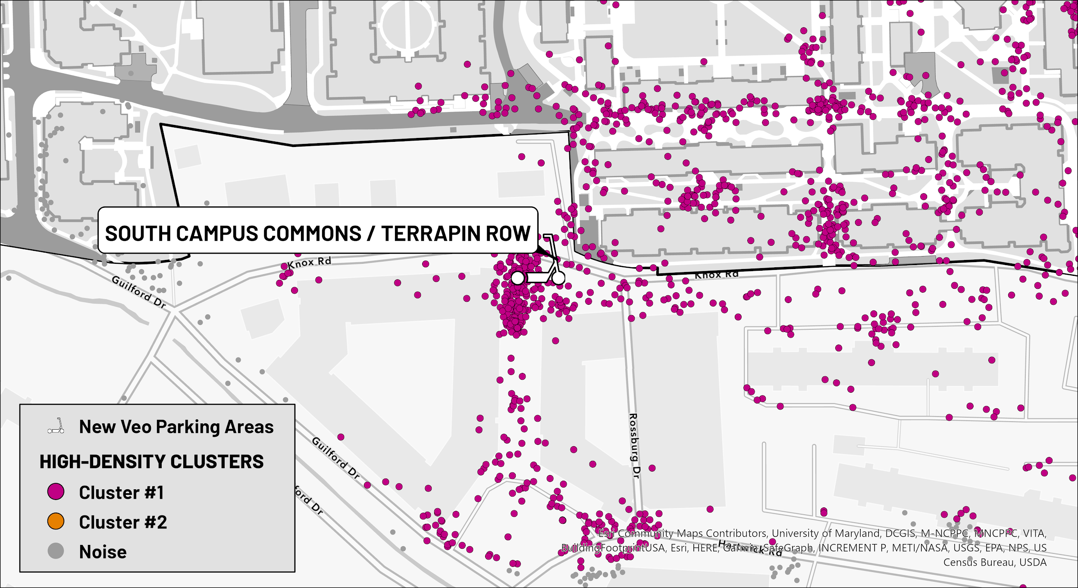
1. Terrapin Row / South Campus Commons
South Campus Commons 4
Terrapin Row
LEGEND

Slide 39
1. Terrapin Row / South Campus Commons
South Campus Commons 4
Terrapin Row
LEGEND
The density in Cluster #1 is dispersed around a wide area, so we are recommending the new station location in between SCC 4 & Terrapin Row--the area farthest from existing parking areas.

Slide 40
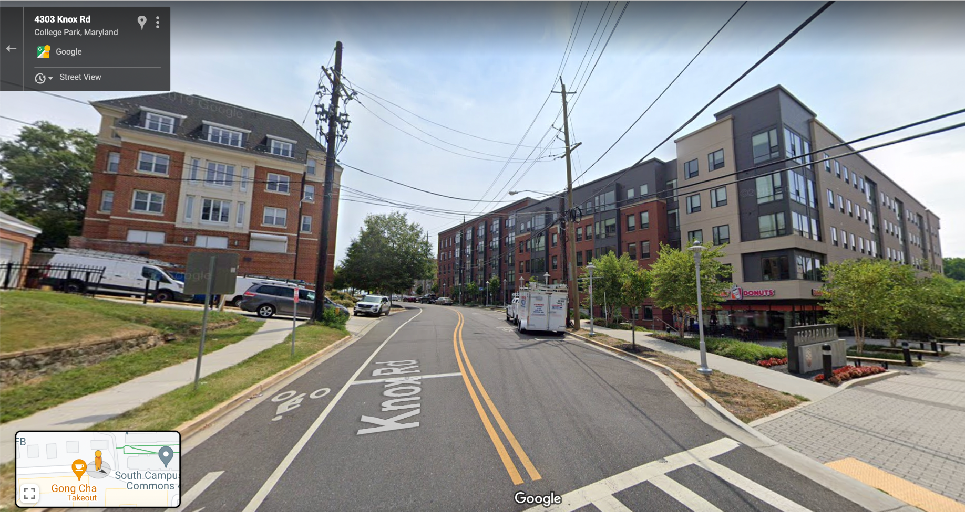
1. Terrapin Row / South Campus Commons - Street View
Terrapin Row
South Campus Commons 4
Terrapin Row & South Campus Commons 4 are among the most popular off-campus housing for UMD students, and it was also a popular bus stop in the bus analysis. They are located right beside The Spot, a popular shopping/dining center. A Veo Parking station here would be ideal for students.

Slide 41
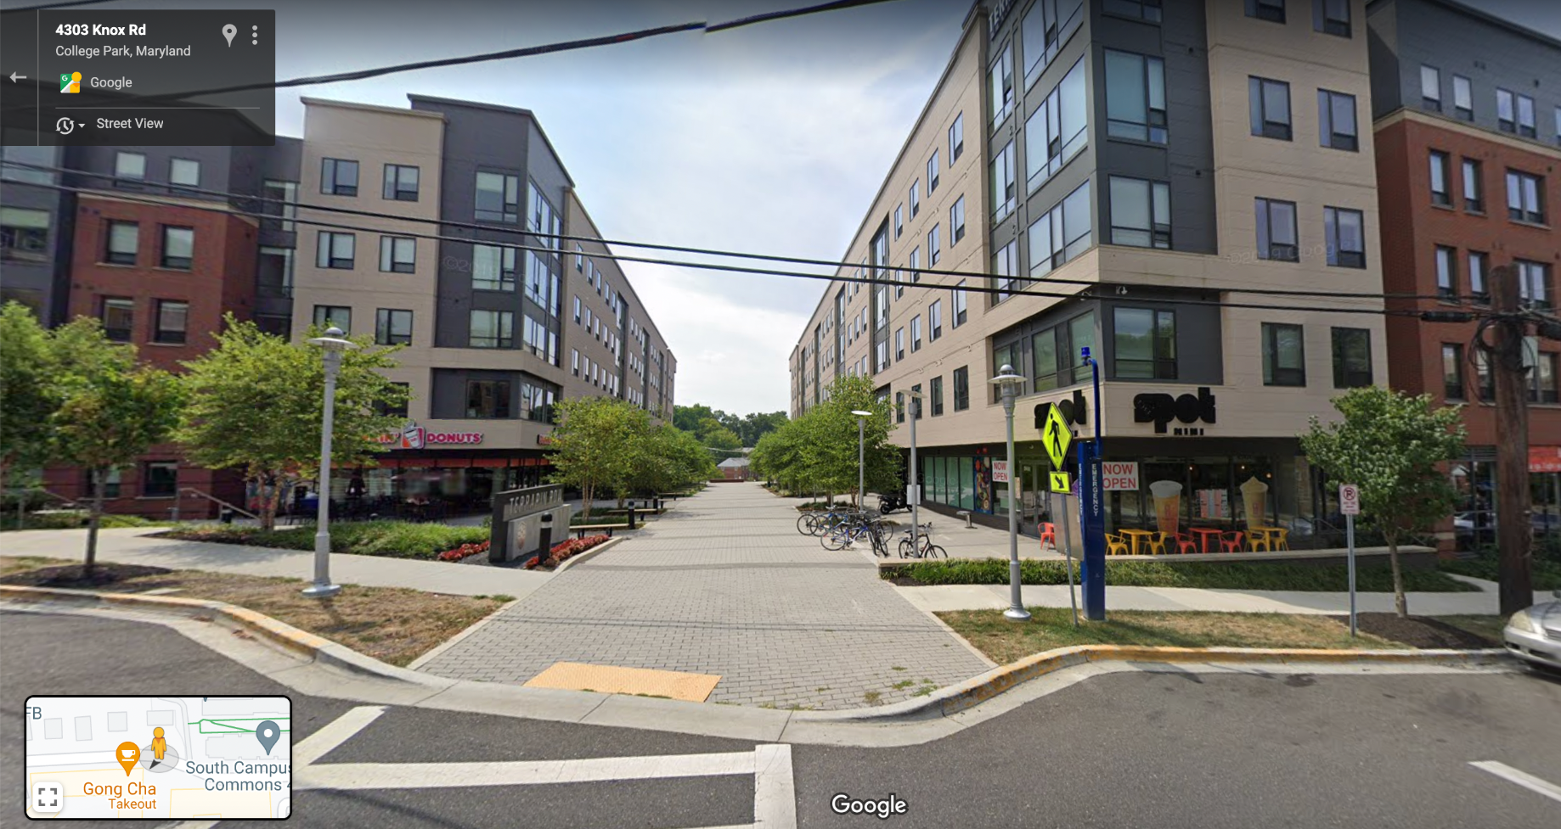
1. Terrapin Row / South Campus Commons - Street View
Bike Rack in front of The Spot on Knox Rd: Ideal location for Veo to add new parking station

Slide 42
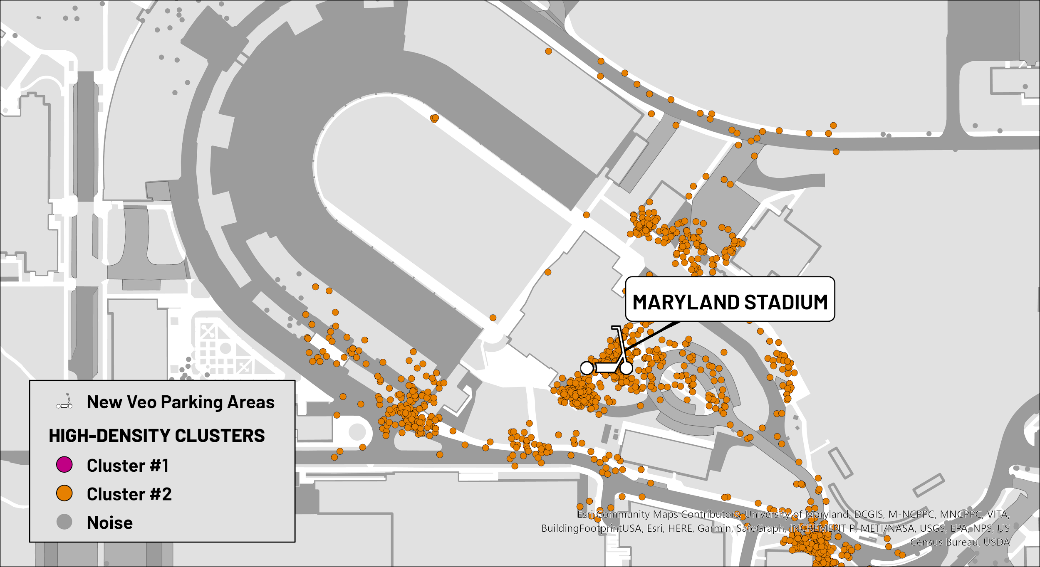
2. Maryland Stadium
Gosset Football Team House
LEGEND

Slide 43
2. Maryland Stadium
The points in Cluster #1 are highly concentrated around the Gosset Football Team House in front of the MD Stadium
Gosset Football Team House
LEGEND

Slide 44
2. Maryland Stadium
Gosset Football Team House is home to UMD’s football team where they train, and is located right in front of the MD Stadium where they hold their games.
Gosset Football Team House
LEGEND

Slide 45
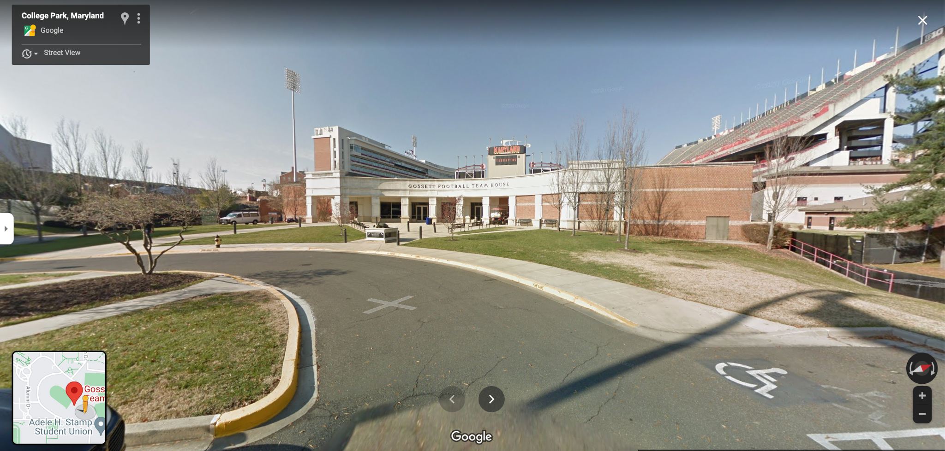
2. Gosset Football Team House (MD Stadium) - Street View

Slide 46
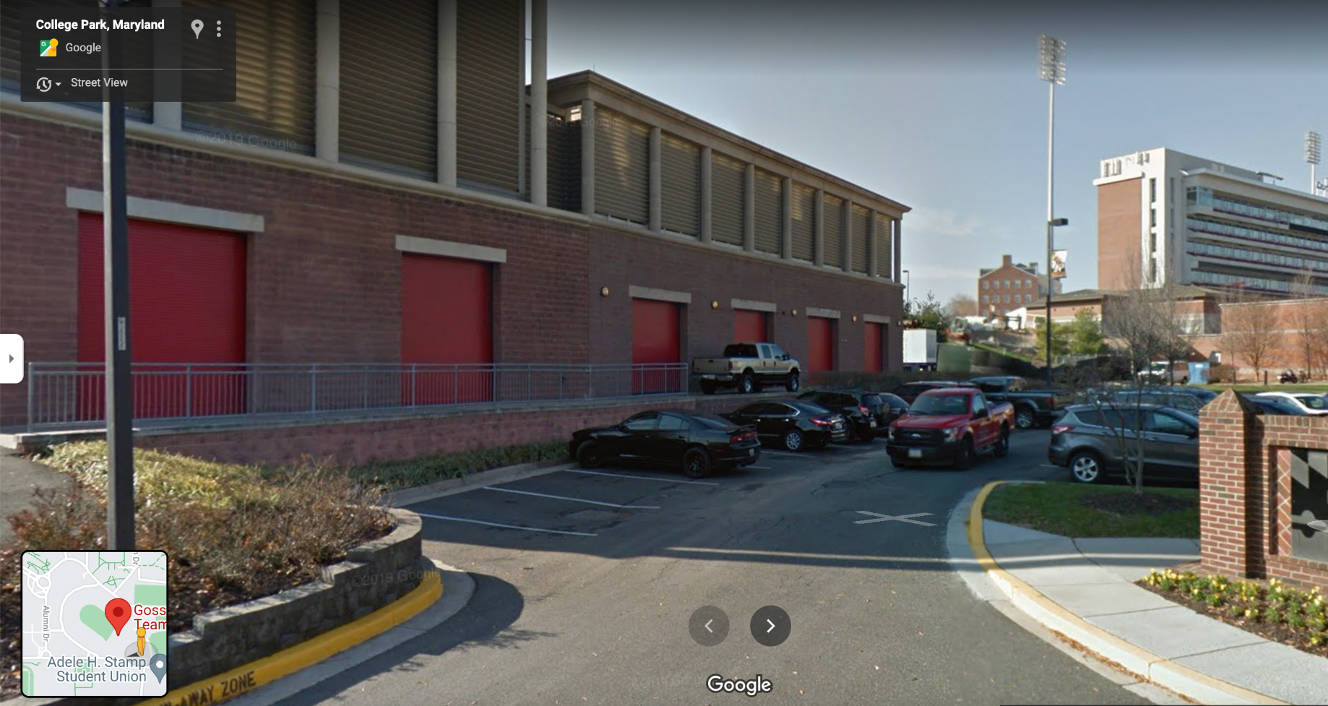
2. Gosset Football Team House (MD Stadium) - Street View
Corner of the parking lot: ideal location for Veo to add a parking station

Slide 47
Thank you for listening!
Questions/Comments?

